Slide 1
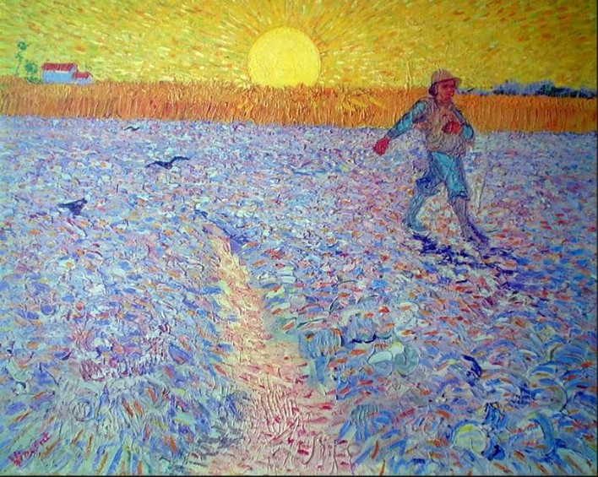
Sowing Seeds of Social Beauty
A Course About:
The Untold Story of the Children’s Hospital Public Economy Model (CHPEM)
And
The Development of
Social Clinicians
Presentation 1:
An Overview of the Course

Slide 2


Slide 3
Sowing Seeds of Social Beauty
Purposes of the Course
Tell the Untold Story of the Children’s Hospital Public Economy
Model (CHPEM) or the Children’s Hospital Model, for short:
    Explain how it profoundly differs from the corporate capitalist economic model.
    Explain why it deserves consideration as an alternative to the corporate capitalist model—particularly in Healthcare, but also in the general economy.

Slide 4
Sowing Seeds of Social Beauty
Purposes of the Course
Encourage physicians to serve not just as physicians for individual patients, but also as Social Clinicians---that is:
    Physicians who are concerned about how ill-health of society might be affecting the health of their patients.
    Physicians who are well-versed in social philosophy, social psychology, and economic models, including the CHPEM;
    Physicians who examine illness of Society, using the same rigorous and altruistic problem-solving approach that they use in the medical clinic;
    Physicians who offer treatment for social illness that is based on root cause.

Slide 5
Sowing Seeds of Social Beauty
Purposes of the Course
A third purpose is to encourage all citizens to serve as Social Clinicians—in their own ways, to the best of their abilities, to the extent that their situations permit.

Slide 6
Sowing Seeds of Social Beauty
Purposes of the Course
A fourth purpose is to stimulate, facilitate, and inform respectful public dialogue about important social and economic topics—namely, the topics that are covered in the book and in the 18 presentations of this course.

Slide 7
List of the Presentations Provided in this Course:
An Overview of the Course
Social Beauty
Children’s Hospital Public Economy Model (CHPEM)
Hugoist Social and Economic Model: The Social, Moral, Economic, and Political Philosophy of Victor Hugo
The Foundational Set of Social Understandings Upon Which the CHPEM is based: Comparison with the Social Understandings Upon Which Capitalism is based
Human Nature
Leadership
Moral Incentive vs. Monetary Incentive
Competition
A “Most Precious Freedom”
Kind Social Arrangements vs. Mean Social Arrangements
The Achilles’ Heel of Capitalism
Kind Social Arrangements vs. Mean Social Arrangements
The Achilles’ Heel of Capitalism
Application of the CHPEM to a General Economy
The Difference Between the CHPEM, State Socialism, Democratic Socialism, Social Democracy, and Communism
A Collaborative International Network of Unique Independent, Creative, Self-Determined, Self-Reliant, Democratic, CHPEM-inspired, National Public Economies
The Social Clinician and the Social Clinic

Slide 8
List of the Presentations Provided in this Course (Cont.):
Application of the CHPEM to a General Economy—A “Third Way”
Anticipated Concerns about Applying the CHPEM to a General Economy
The Difference between the CHPEM and Other Economic Models
Development of a Collaborative International Network of Unique Independent, Creative, Self-Determined, Self-Reliant, Democratic, CHPEM-Inspired, Hugo-Inspired National Public Economies—as an alternative to global corporate capitalism
The Need for Social Clinicians and Social Clinics
The Role of Pediatricians and Children’s Hospitals in Creating a Healthier World

Slide 9
List of the Presentations Provided in this Course:
Overview of the Course
Social Beauty
Children’s Hospital Public Economy Model (CHPEM)
Hugoist Social and Economic Model: The Social, Moral, Economic, and Political Philosophy of Victor Hugo
The Foundational Set of Social Understandings Upon Which the CHPEM is based: Comparison with the Social Understandings Upon Which Capitalism is based
Human Nature
Leadership
Moral Incentive vs. Monetary Incentive
Competition
A “Most Precious Freedom”
Kind Social Arrangements vs. Mean Social Arrangements
The Achilles’ Heel of Capitalism
Kind Social Arrangements vs. Mean Social Arrangements
The Achilles’ Heel of Capitalism
Application of the CHPEM to a General Economy
The Difference Between the CHPEM, State Socialism, Democratic Socialism, Social Democracy, and Communism
A Collaborative International Network of Unique Independent, Creative, Self-Determined, Self-Reliant, Democratic, CHPEM-inspired, National Public Economies
The Social Clinician and the Social Clinic

Slide 10
A Definition of Social Beauty
Social Beauty refers to any social arrangement, social activity, or social behavior that, when witnessed or experienced, warmly touches the human heart, uplifts the human spirit, reminds us of the best behavioral capacities of our human nature (e.g., our capacities for empathy, compassion, altruism, kindness, and creativity), elevates feelings of gratitude for Life and each other (including gratitude for opportunities to contribute to the well-being of others), and makes one proud to be a part of Humanity.
Social Beauty is the product of Kind Social Arrangements (and the social activities and social behaviors generated by those arrangements) and those Kind Social Arrangements are, themselves, things of Social Beauty.

Slide 11
List of the Presentations Provided in this Course:
Overview of the Course
Social Beauty
Children’s Hospital Public Economy Model (CHPEM)
Hugoist Social and Economic Model: The Social, Moral, Economic, and Political Philosophy of Victor Hugo
The Foundational Set of Social Understandings Upon Which the CHPEM is based: Comparison with the Social Understandings Upon Which Capitalism is based
Human Nature
Leadership
Moral Incentive vs. Monetary Incentive
Competition
A “Most Precious Freedom”
Kind Social Arrangements vs. Mean Social Arrangements
The Achilles’ Heel of Capitalism
Kind Social Arrangements vs. Mean Social Arrangements
The Achilles’ Heel of Capitalism
Application of the CHPEM to a General Economy
The Difference Between the CHPEM, State Socialism, Democratic Socialism, Social Democracy, and Communism
A Collaborative International Network of Unique Independent, Creative, Self-Determined, Self-Reliant, Democratic, CHPEM-inspired, National Public Economies
The Social Clinician and the Social Clinic

Slide 12
Children’s Hospitals
How and why Public Children’s Hospitals came into being.
How they were initially organized, operated, and funded.
What the culture was like.
What the guiding social understandings and behavioral principles were.
How the CHPEM generated great Social Beauty.

Slide 13
The “Social Beauty Era”
(the “Altruistic Era” or the “CHPEM Era”)
1955-1995
The “Corporate Era”
1995-present

Slide 14
List of the Presentations Provided in this Course:
Overview of the Course
Social Beauty
Children’s Hospital Public Economy Model (CHPEM)
Hugoist Public Economy Model: The Social, Moral, Economic, and Political Philosophy of Victor Hugo
The Foundational Set of Social Understandings Upon Which the CHPEM is based: Comparison with the Social Understandings Upon Which Capitalism is based
Human Nature
Leadership
Moral Incentive vs. Monetary Incentive
Competition
A “Most Precious Freedom”
Kind Social Arrangements vs. Mean Social Arrangements
The Achilles’ Heel of Capitalism
Kind Social Arrangements vs. Mean Social Arrangements
The Achilles’ Heel of Capitalism
Application of the CHPEM to a General Economy
The Difference Between the CHPEM, State Socialism, Democratic Socialism, Social Democracy, and Communism
A Collaborative International Network of Unique Independent, Creative, Self-Determined, Self-Reliant, Democratic, CHPEM-inspired, National Public Economies
The Social Clinician and the Social Clinic

Slide 15
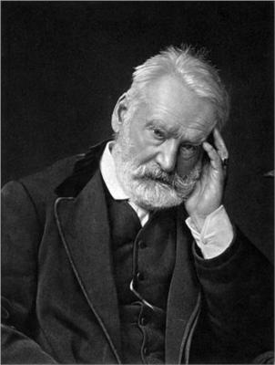

The Social, Moral, and Economic Philosophy of Victor Hugo
Victor Hugo was a Social Clinician who believed in the imperishability and grandeur of the human soul. Guided by conscience, he sought root cause and offered uplifting analysis and remedy. He believed in “Vast Fields of Public Activity”
1802-1885
1862
Notes:
.

Slide 16
The Philosophy of Victor Hugo
He had a positive view of Human Nature.
He believed that, under the right conditions, Humanity had great potential to create abundant Social Beauty.
He had enormous compassion for all living things, especially the most vulnerable.
He believed “the highest Duty is to think of others; the highest Justice is Conscience.”
He believed strongly in Public Economy (i.e., in creating “vast fields of public activity”) and in creating “schools for all aptitudes.”
He was conservative, liberal, radical, progressive, and revolutionary---all at the same time. No one label does justice to his philosophy.

Slide 17
List of the Presentations Provided in this Course:
Overview of the Course
Social Beauty
Children’s Hospital Public Economy Model (CHPEM)
Hugoist Social and Economic Model: The Social, Moral, Economic, and Political Philosophy of Victor Hugo
The Foundational Set of Social Understandings Upon Which the CHPEM is based: Comparison with the Social Understandings Upon Which Capitalism is based
Human Nature
Leadership
Moral Incentive vs. Monetary Incentive
Competition
A “Most Precious Freedom”
Kind Social Arrangements vs. Mean Social Arrangements
The Achilles’ Heel of Capitalism
Kind Social Arrangements vs. Mean Social Arrangements
The Achilles’ Heel of Capitalism
Application of the CHPEM to a General Economy
The Difference Between the CHPEM, State Socialism, Democratic Socialism, Social Democracy, and Communism
A Collaborative International Network of Unique Independent, Creative, Self-Determined, Self-Reliant, Democratic, CHPEM-inspired, National Public Economies
The Social Clinician and the Social Clinic

Slide 18
The Set of Social Understandings Upon Which the CHPEM is based
Regarding:
Human Nature
Leadership
Motivation/Incentive
Competition
Freedom
The CHPEM’s understandings of these five concepts are completely different from Capitalism’s understandings of them.

Slide 19
List of the Presentations Provided in this Course:
Overview of the Course
Social Beauty
Children’s Hospital Public Economy Model (CHPEM)
Hugoist Social and Economic Model: The Social, Moral, Economic, and Political Philosophy of Victor Hugo
The Foundational Set of Social Understandings Upon Which the CHPEM is based: Comparison with the Social Understandings Upon Which Capitalism is based
Human Nature
Leadership
Moral Incentive vs. Monetary Incentive
Competition
A “Most Precious Freedom”
Kind Social Arrangements vs. Mean Social Arrangements
The Achilles’ Heel of Capitalism
Kind Social Arrangements vs. Mean Social Arrangements
The Achilles’ Heel of Capitalism
Application of the CHPEM to a General Economy
The Difference Between the CHPEM, State Socialism, Democratic Socialism, Social Democracy, and Communism
A Collaborative International Network of Unique Independent, Creative, Self-Determined, Self-Reliant, Democratic, CHPEM-inspired, National Public Economies
The Social Clinician and the Social Clinic

Slide 20
Regarding Human Nature
The CHPEM is based on a positive, complex, nuanced, pro-human view of human nature. While acknowledging that all of us have both altruistic and non-altruistic behavioral capacities within our individual human natures, the CHPEM seeks to emphasize and upregulate expression of the altruistic rather than the non-altruistic capacities.

Slide 21
Regarding Human Nature
The corporate capitalist economic model espouses a negative, simplistic, incomplete view of Human Nature---one that emphasizes the non-altruistic capacities of our human nature and inevitably upregulates expression of those capacities.
While the CHPEM encourages faith in Human Goodness, the capitalist model discourages faith in Human Goodness and gives the message that human beings are primarily selfish and rather hopelessly so. The capitalist view of Human Nature is rather anti-human. It claims that, by nature, we “are not good enough” to successfully practice any alternative to capitalism, and only disaster will result if we try.

Slide 22
Regarding Human Nature
While the CHPEM emphasizes that the social milieu can upregulate or downregulate expression of given capacities of our human nature, the capitalist model largely ignores the effect of the social milieu on expression of the various capacities of our Human Nature.
These contrasting views of Human Nature are at the heart of what is problematic about the capitalist model and what is helpful and healthy about the CHPEM.

Slide 23
List of the Presentations Provided in this Course:
Overview of the Course
Social Beauty
Children’s Hospital Public Economy Model (CHPEM)
Hugoist Social and Economic Model: The Social, Moral, Economic, and Political Philosophy of Victor Hugo
The Foundational Set of Social Understandings Upon Which the CHPEM is based: Comparison with the Social Understandings Upon Which Capitalism is based
Human Nature
Leadership
Moral Incentive vs. Monetary Incentive
Competition
A “Most Precious Freedom”
Kind Social Arrangements vs. Mean Social Arrangements
The Achilles’ Heel of Capitalism
Kind Social Arrangements vs. Mean Social Arrangements
The Achilles’ Heel of Capitalism
Application of the CHPEM to a General Economy
The Difference Between the CHPEM, State Socialism, Democratic Socialism, Social Democracy, and Communism
A Collaborative International Network of Unique Independent, Creative, Self-Determined, Self-Reliant, Democratic, CHPEM-inspired, National Public Economies
The Social Clinician and the Social Clinic

Slide 24
Regarding Leadership and Kind Social Arrangements vs. Mean Social Arrangements
With the CHPEM, positions of leadership are populated with “natural altruistic leaders,” meaning individuals who are naturally inclined, easily able, and greatly prefer to express the kind, altruistic capacities of our human nature and do so in exemplary fashion. These natural altruistic leaders are among the kindest, most competent, and least corruptible among us. That is why they are asked to lead. Such leaders create Kind Social Arrangements that, in turn, lead to Social Beauty.

Slide 25
Leadership
In contrast, positions of leadership in a corporate capitalist economy are deliberately populated with individuals who are deemed most likely to benefit the bottom line of corporations. These tend to be individuals who have enthusiastically embraced the flawed social understandings upon which capitalism is based and are particularly inclined, willing, and able to upregulate expression of the non-altruistic behavioral capacities that create wealth. Such individuals tend to create Mean Social Arrangements that, in turn, lead to Social Atrocity.

Slide 26
Examples of Mean Social Arrangements
When a US mining corporation works with the US government to arrange for a preferred corrupt pro-American individual in a natural resources-rich foreign country to become the President of that country, and that President, who was not truly democratically elected, then arranges for the US government and the US mining corporation to have full profitable access to those natural resources and turns a blind eye to the exploitation of child labor to do dangerous mining work, and that President personally receives millions of dollars for collaborating with the US and arranges to have so little of the mining profits placed in that country’s treasury that the people of that country remain poor, miserable, and without adequate healthcare, education, or other social services---those are Mean Social Arrangements and those are Social Atrocities.

Slide 27

Child laborers inside a cobalt mine in the Congo
Cobalt is an essential ingredient of lithium-ion batteries that power
I-Phones, laptops, electric vehicles, electric bicycles, large AI Data Centers, large-scale energy storage systems, etc..
Cobalt is in huge demand!

Slide 28
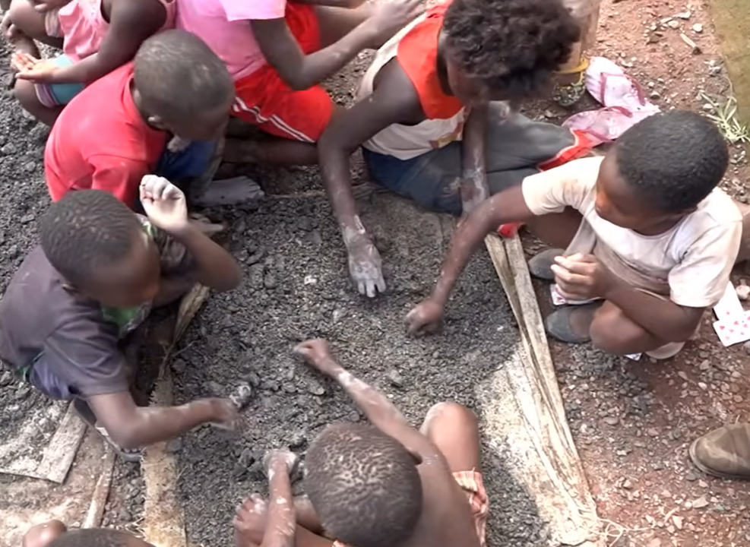
Children sifting through rock rubble to find and sort cobalt-rich rocks, which are then washed in nearby pools of muddy water

Slide 29
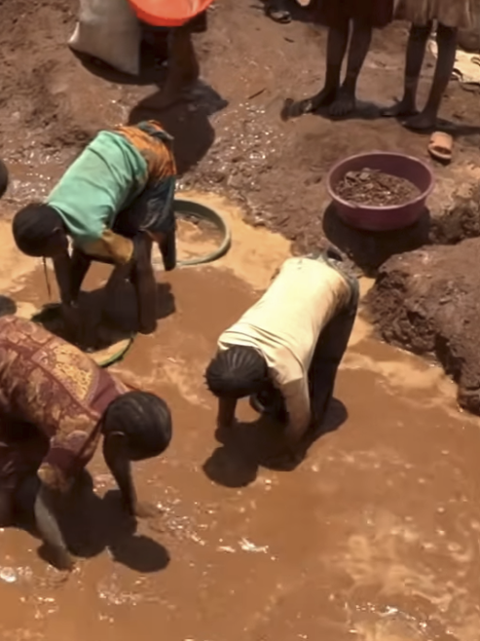
Children washing cobalt-rich rubble rocks in pools of muddy water

Slide 30

A child being loaded up with a sack of cobalt-rich rocks.

Slide 31

The same child carrying that same sack
So, when you think of the corporations that produce I-Phones, laptops, electric cars, and electric bicycles, and are involved in the promotion of large AI Data Centers and large-scale energy storage systems,
remember these children and think of the cobalt mining corporations.

Slide 32
Moreover, when natural altruistic leaders in those exploited countries have resisted these Mean Social Arrangements and Social Atrocities, arrangements have been made to assassinate or otherwise eliminate those leaders.

Slide 33
Assassinated African Leaders of Resistance
1961: Patrice Lumumba—Democratic Republic of the Congo
1963: Sylvanus Olympio—Togo
1966: Sir AbubakarTafawa Balewa--First Prime Minister of Nigeria
1966: Sir Ahmadu BelloPrime Minister of North Nigeria
1969: Eduardo Mandlone--Mozambique
1973: Amilcar Cabral—Guinea-Bissau
1974: Abram Onkgopostse Tiro—South Africa
1975: Samora Moise Machel—Mozambique
1978: Thomas Sankara—Burkina Faso
1993: Chris Hani—South Africa

Slide 34
These are the kinds of sick arrangements that Victor Hugo would call “Mean Arrangements of Man,” and that I call “Mean Social Arrangements” and “Social Atrocities.”
They are directly related to the unfortunate set of social understandings (mis-understandings) upon which capitalism is based, including capitalism’s understanding of leadership.

Slide 35
Leadership
It is no wonder, then, that the world is in such a mess!!
  The corporate capitalist economic model has dominated the global economy and global society.
  This model has placed its preferred non-altruistic “leaders” in positions of power, throughout corporations and throughout complicit governments, globally.
  These “leaders” tend to create (or agree to) Mean Social Arrangements.
  The predictable result is one Social Atrocity after another.

Slide 36
List of the Presentations Provided in this Course:
Overview of the Course
Social Beauty
Children’s Hospital Public Economy Model (CHPEM)
Hugoist Social and Economic Model: The Social, Moral, Economic, and Political Philosophy of Victor Hugo
The Foundational Set of Social Understandings Upon Which the CHPEM is based: Comparison with the Social Understandings Upon Which Capitalism is based
Human Nature
Leadership
Moral Incentive vs. Monetary Incentive
Competition
A “Most Precious Freedom”
Kind Social Arrangements vs. Mean Social Arrangements
The Achilles’ Heel of Capitalism
Kind Social Arrangements vs. Mean Social Arrangements
The Achilles’ Heel of Capitalism
Application of the CHPEM to a General Economy
The Difference Between the CHPEM, State Socialism, Democratic Socialism, Social Democracy, and Communism
A Collaborative International Network of Unique Independent, Creative, Self-Determined, Self-Reliant, Democratic, CHPEM-inspired, National Public Economies
The Social Clinician and the Social Clinic

Slide 37
Moral Incentive vs. Monetary Incentive
The CHPEM encourages “moral incentive” and discourages “monetary incentive.” According to the CHPEM, monetary incentive is neither necessary nor desirable.
According to the corporate capitalist model, monetary incentive is essential, because “without it, people will not have sufficient incentive to work optimally hard or well.”

Slide 38
List of the Presentations Provided in this Course:
Overview of the Course
Social Beauty
Children’s Hospital Public Economy Model (CHPEM)
Hugoist Social and Economic Model: The Social, Moral, Economic, and Political Philosophy of Victor Hugo
The Foundational Set of Social Understandings Upon Which the CHPEM is based: Comparison with the Social Understandings Upon Which Capitalism is based
Human Nature
Leadership
Moral Incentive vs. Monetary Incentive
Competition
A “Most Precious Freedom”
Kind Social Arrangements vs. Mean Social Arrangements
The Achilles’ Heel of Capitalism
Kind Social Arrangements vs. Mean Social Arrangements
The Achilles’ Heel of Capitalism
Application of the CHPEM to a General Economy
The Difference Between the CHPEM, State Socialism, Democratic Socialism, Social Democracy, and Communism
A Collaborative International Network of Unique Independent, Creative, Self-Determined, Self-Reliant, Democratic, CHPEM-inspired, National Public Economies
The Social Clinician and the Social Clinic

Slide 39
The CHPEM understands that the word “competition” comes from the two Latin words “com” and “petere,” which mean “with (or together)” and “to seek,” respectively. Accordingly, the CHPEM promotes the notion that the purpose of competition is to help each other “to seek [new heights] together,” in a spirited way, such that all improve.
The corporate capitalist model promotes the notion that competition is all about winning, beating, defeating, and eliminating. It is a rather cut-throat, inaccurate, crude, perversion of what the word “competition” truly means.

Slide 40
List of the Presentations Provided in this Course:
Overview of the Course
Social Beauty
Children’s Hospital Public Economy Model (CHPEM)
Hugoist Social and Economic Model: The Social, Moral, Economic, and Political Philosophy of Victor Hugo
The Foundational Set of Social Understandings Upon Which the CHPEM is based: Comparison with the Social Understandings Upon Which Capitalism is based
Human Nature
Leadership
Moral Incentive vs. Monetary Incentive
Competition
A “Most Precious Freedom”
Kind Social Arrangements vs. Mean Social Arrangements
The Achilles’ Heel of Capitalism
Kind Social Arrangements vs. Mean Social Arrangements
The Achilles’ Heel of Capitalism
Application of the CHPEM to a General Economy
The Difference Between the CHPEM, State Socialism, Democratic Socialism, Social Democracy, and Communism
A Collaborative International Network of Unique Independent, Creative, Self-Determined, Self-Reliant, Democratic, CHPEM-inspired, National Public Economies
The Social Clinician and the Social Clinic

Slide 41
A Most Precious Freedom
From the CHPEM’s point of view, one of the most precious freedoms is the freedom that comes from participating in comprehensive public efforts to genuinely look after others; the freedom to enjoy widespread up-regulated expressions of the human capacity for kindness--in oneself and in the larger society, which are inter-dependent. This freedom is generated by social arrangements and social activities that generate Social Beauty. This freedom is spotty in societies dominated by corporate capitalism.
According to the corporate capitalist point of view, individual liberty and the freedom to maximally pursue one’s self-interest are the most precious freedoms.

Slide 42
List of the Presentations Provided in this Course:
Overview of the Course
Social Beauty
Children’s Hospital Public Economy Model (CHPEM)
Hugoist Social and Economic Model: The Social, Moral, Economic, and Political Philosophy of Victor Hugo
The Foundational Set of Social Understandings Upon Which the CHPEM is based: Comparison with the Social Understandings Upon Which Capitalism is based
Human Nature
Leadership
Moral Incentive vs. Monetary Incentive
Competition
A “Most Precious Freedom”
Kind Social Arrangements vs. Mean Social Arrangements
The Achilles’ Heel of Capitalism
Kind Social Arrangements vs. Mean Social Arrangements
The Achilles’ Heel of Capitalism
Application of the CHPEM to a General Economy
The Difference Between the CHPEM, State Socialism, Democratic Socialism, Social Democracy, and Communism
A Collaborative International Network of Unique Independent, Creative, Self-Determined, Self-Reliant, Democratic, CHPEM-inspired, National Public Economies
The Social Clinician and the Social Clinic

Slide 43
Kind Social Arrangements vs. Mean Social Arrangements
Presentation 11 explains how the CHPEM creates Kind Social Arrangements and Social Beauty—thanks to the altruistic goals it sets, the type of leaders it elects, and the behaviors it promotes---while the corporate capitalist model tends to create Mean Social Arrangements and Social Atrocity—thanks to the goals it sets, the type of leaders it empowers, and the behaviors it promotes.

Slide 44
List of the Presentations Provided in this Course:
Overview of the Course
Social Beauty
Children’s Hospital Public Economy Model (CHPEM)
Hugoist Social and Economic Model: The Social, Moral, Economic, and Political Philosophy of Victor Hugo
The Foundational Set of Social Understandings Upon Which the CHPEM is based: Comparison with the Social Understandings Upon Which Capitalism is based
Human Nature
Leadership
Moral Incentive vs. Monetary Incentive
Competition
A “Most Precious Freedom”
Kind Social Arrangements vs. Mean Social Arrangements
The Achilles’ Heel of Capitalism
Kind Social Arrangements vs. Mean Social Arrangements
The Achilles’ Heel of Capitalism
Application of the CHPEM to a General Economy
The Difference Between the CHPEM, State Socialism, Democratic Socialism, Social Democracy, and Communism
A Collaborative International Network of Unique Independent, Creative, Self-Determined, Self-Reliant, Democratic, CHPEM-inspired, National Public Economies
The Social Clinician and the Social Clinic

Slide 45
The Achilles’ Heel of Capitalism
The Achilles’ heel of capitalism is the unfortunate set of highly flawed social understandings upon which it is based. The corporate capitalist economic model not only promotes this set of flawed understandings, but it also depends on uncritical or unwitting public acceptance of these understandings as wise and true (despite these understandings being unwise and inaccurate). In other words, the capitalist model depends on gaslighting the public into accepting the social understandings upon which this model is based.

Slide 46
Gaslighting is a form of psychological abuse!
Once the majority of the public realizes that they have been gaslit by the dogmas of capitalism, it is likely that the power and appeal of the capitalist model will greatly diminish

Slide 47
List of the Presentations Provided in this Course (Cont.):
Application of the CHPEM to a General Economy—A “Third Way”
Anticipated Concerns about Applying the CHPEM to a General Economy
The Difference between the CHPEM and Other Economic Models
Development of a Collaborative International Network of Unique Independent, Creative, Self-Determined, Self-Reliant, Democratic, CHPEM-Inspired, Hugo-inspired, National Public Economies—as an alternative to global corporate capitalism
The Need for Social Clinicians and Social Clinics
The Role of Pediatricians and Children’s Hospitals in Creating a Healthier World

Slide 48
At the very least, should the CHPEM be applied to the entirety of the healthcare system, including the pharmaceutical industry?
Should application of the CHPEM to the general economy also be considered?
How, exactly, could the CHPEM be implemented within a general economy? What careful pre- and post-implementation steps would be necessary?
Would it co-exist with private sector capitalist enterprises? Or completely replace capitalism? Would private sector “free enterprises” be permitted?

Slide 49
List of the Presentations Provided in this Course (Cont.):
Application of the CHPEM to a General Economy—A “Third Way”
Anticipated Concerns about Applying the CHPEM to a General Economy
The Difference between the CHPEM and Other Economic Models
Development of a Collaborative International Network of Unique Independent, Creative, Self-Determined, Self-Reliant, Democratic CHPEM-Inspired, Hugo-inspired, National Public Economies—as an alternative to global corporate capitalism
The Need for Social Clinicians and Social Clinics
The Role of Pediatricians and Children’s Hospitals in Creating a Healthier World

Slide 50
Anticipated Fears about Applying the CHPEM to the General Economy:
Would private sector free enterprise be permitted? (The answer is, Yes.)
Fears about:
  Potential unfairness and corruption on the part of the economy’s leaders
  Potential authoritarianism/fascism
  Potential loss of freedom, democracy, and individual liberty
  Potential loss of control over one’s life, one’s choices, one’s opportunities
  Loss of innovation and creativity
  “Too bureaucratic,” too centralized?
  “Too Idealistic, Won’t work”
  “People are too selfish”

Slide 51
The CHPEM has been practiced in children’s hospitals for decades and, during the “Social Beauty Era,” there was little or no evidence that any of these feared problems occurred to any significant degree in these hospitals.
It was only during the “Corporate Era” of children’s hospitals that corruption, authoritarianism, loss of freedom, loss of democracy, etc. became realities and occurred to a worrisome degree within children’s hospitals.

Slide 52
I would point out that the “Social Beauty Era” of children’s hospitals was wonderfully successful and full of Social Beauty, while the “Corporate Era” has been disappointing and alarming to physicians, nurses, hospital workers, and patients alike.
So, based on established track records, which model warrants the most fear and concern?

Slide 53
I don’t mean to imply that the Social Beauty Era was perfect, because it was not. But the level of imperfection during the Social Beauty Era was far less than the level of imperfection that has been obvious and enormously concerning during the Corporate Era.
It is interesting that many people are afraid to even consider applying the CHPEM to the general economy because they fear that such application might, possibly result in some worrisome behaviors. But they are willing to allow continuation of a model (corporate capitalism) that has already proven to definitely result in horrible behaviors---rampant corruption, exploitation, mean social arrangements, and horrible social atrocities.

Slide 54
In my opinion, if both the CHPEM and corporate capitalism were practiced in the same general economy, and if the majority of the public thoroughly and accurately understood both models, public support for excellent CHPEM-created public activities/enterprises would steadily increase and public support for capitalism’s private enterprise counterparts would steadily diminish, to the point that, eventually, few of the latter would remain in business.
This may seem unlikely to many, but it is the power of ideas; the power of education and healthy dialogue; the power of “pride in being public;” and the desperate longing for greater meaningfulness, greater and healthier social connection, and greater Social Beauty that will ultimately prevail.

Slide 55
Some will argue that the CHPEM may be very appropriate and successful in the healthcare arena but would not be appropriate or successful in the general economy. Where is the evidence that this point of view is correct? How thoroughly has this claim been examined?
Finally, to those who are afraid to consider application of the CHPEM to the general economy as an alternative to corporate capitalism, I would ask:
Is it possible that you are letting fear stand in the way of experiencing something wonderful?

Slide 56
List of the Presentations Provided in this Course (Cont.):
Application of the CHPEM to a General Economy—A “Third Way”
Anticipated Concerns about Applying the CHPEM to a General Economy
The Difference between the CHPEM and Other Economic Models
Development of a Collaborative International Network of Unique Independent, Creative, Self-Determined, Self-Reliant, Democratic, CHPEM-Inspired, Hugo-inspired National Public Economies—as an alternative to global corporate capitalism
The Need for Social Clinicians and Social Clinics
The Role of Pediatricians and Children’s Hospitals in Creating a Healthier World

Slide 57
The Difference Between the CHPEM and other Social and Economic Models:
The difference between the CHPEM and:
  “State Capitalism”
  “State Socialism”
  “Democratic Socialism”
  “Social Democracy”
  Communism

Slide 58
In my opinion, the CHPEM/Hugoist Public Economy Model represents a social, moral, political, and economic model that both the most kind and altruistic capitalists and the most kind and altruistic socialists might mutually view as an attractive “Third Way.”

Slide 59
List of the Presentations Provided in this Course (Cont.):
Application of the CHPEM to a General Economy—A “Third Way”
Anticipated Concerns about Applying the CHPEM to a General Economy
The Difference between the CHPEM and Other Economic Models
Development of a Collaborative International Network of Unique, Independent (Sovereign), Creative, Self-Determined, Self-Reliant, Democratic, CHPEM-Inspired, Hugo-inspired, National Public Economies—as an alternative to global corporate capitalism
The Need for Social Clinicians and Social Clinics
The Role of Pediatricians and Children’s Hospitals in Creating a Healthier World

Slide 60
This Collaborative International Network of National Public Economies is totally different from the rapidly declining Unipolar (USA-dominated) Global Economy, totally different from the rapidly rising multi-polar BRICS+ Global Economy, and even more totally different from the hideously technocratic “One World Government” envisioned by the obscenely wealthy Transnational Ultra-Capitalists (and their obedient chosen “leaders”) who attend the World Economic Forum in Davos each year.
Unlike the Collaborative International Network of National Public Economies, all three of these other global economic models are capitalist. (China, for example, practices a form of “state capitalism,” mixed with controlled private sector capitalism)

Slide 61
The Collaborative International Network of National Public Economies is similar to the informal collaborative international network of academic pediatricians and children’s hospitals that has altruistically and amicably shared information and expertise with one another, globally, for decades.
The Collaborative International Network encourages application of the CHPEM to the general economy of any nation. The CHPEM, or the Hugoist Economic Model, represents a “Third Way.” It represents an alternative to private sector capitalism, state capitalism, socialism, communism, and the hideously technocratic “One World Government.”
It is likely that both the kindest, most altruistic capitalists and the kindest, most altruistic socialists, will find the CHPEM to be attractive---because it is consistent with their most cherished beliefs, principles, goals, and preferred behaviors.

Slide 62
List of the Presentations Provided in this Course (Cont.):
Application of the CHPEM to a General Economy—A “Third Way”
Anticipated Concerns about Applying the CHPEM to a General Economy
The Difference between the CHPEM and Other Economic Models
Development of a Collaborative International Network of Unique Independent, Creative, Self-Determined, Self-Reliant, Democratic, CHPEM-Inspired, Hugo-inspired National Public Economies—as an alternative to global corporate capitalism
The Need for Social Clinicians and Social Clinics
The Role of Pediatricians and Children’s Hospitals in Creating a Healthier World

Slide 63
The Social Clinician and the Social Clinic
When a little boy develops high fever, cough, chest pain, and lethargy, his worried parents bring him to the Children’s Clinic, where a physician carefully elicits the chief complaint, obtains a complete past and present history, auscultates (listens to) his chest and heart, palpates his abdomen, completes a thorough physical examination, considers the full range of possible root causes, conducts further testing, discusses the most likely cause, and offers treatment that best balances concerns about benefit and risk. Such is the pediatrician’s approach to addressing an individual patient’s sickness.

Slide 64
When society becomes inflamed, coughs up anger, is in pain, and is worried, who auscultates its heart and lungs? Who palpates society’s underbelly? Who are the Physicians for Society? Where are the Social Clinicians? Where is the Social Clinic? Where is root cause being sought?
What problem-solving approach could be practiced in a Social Clinic, and what diagnosis and remedy could emerge from it?

Slide 65
Or, fearful of what the diagnosis or treatment recommendations might be, have we been afraid to bring illnesses of society before the Social Clinic? Have we been afraid to expose root cause? Have we been too busy, or too stressed, or become too pessimistic, or felt too hopeless to want to serve as Social Clinicians? Have we, instead, allowed social illness to fester---undiagnosed, untreated, and only half-examined, half-understood?

Slide 66
World civilization is obviously seriously ill and in urgent need of thorough evaluation. There is inflammation everywhere---wars, terrorism, racism, exploitation, simplistic and intolerant polarization, and both violent and unspoken anger. There is obscene income inequality and global economic instability, as individual corporations and individual countries have greedily pursued their self-interests, often ruthlessly. Close to a billion of the world’s people live in extreme poverty, with little or no access to health care and little hope for a better life.

Slide 67
Even in one of the world’s wealthiest countries (USA) health care is largely unaffordable, many people are hopelessly in debt, and many are suffering from deeply sickened souls. Gross mis-education, including failure to obtain and learn from an accurate past and present history, has led to excessive fears, confusion, intolerance, and polarization, which have amplified global illness.

Slide 68
And, the earth itself is suffering mightily, from pollution and exploitation---soon to be irreversibly damaged, if not already. Mother Earth---including its oceans, atmosphere, soil, plants, animals, and insects---is crying!

Slide 69
Never has it been more important to bring social problems before the Social Clinic. Never has it been more important for as many people as possible to participate in the Social Clinic, to help determine, democratically, through careful analysis and respectful dialogue, the root cause(s) of and best remedy(ies) for current global social illness.

Slide 70
List of the Presentations Provided in this Course (Cont.):
Application of the CHPEM to a General Economy—A “Third Way”
Anticipated Concerns about Applying the CHPEM to a General Economy
The Difference between the CHPEM and Other Economic Models
Development of a Collaborative International Network of Unique Independent, Creative, Self-Determined, Self-Reliant, Democratic, CHPEM-Inspired, Hugo-inspired National Public Economies—as an alternative to global corporate capitalism
The Need for Social Clinicians and Social Clinics
The Role of Pediatricians and Children’s Hospitals in Creating a Healthier World

Slide 71
Pediatricians and Children’s Hospitals Can Lead the Way
In fact, pediatricians and children’s hospitals are particularly well-suited to lead the way:
  For decades, we have naturally practiced the altruistic Children’s Hospital Public Economy Model (CHPEM), globally.
  We know that the CHPEM can work spectacularly well. We have developed hard-won confidence in it.
  We have experienced the negative results when corporate beliefs and practices were undemocratically imposed on children’s hospitals, thereby replacing the CHPEM with a corporate capitalist model.
  We are accustomed to practicing a disciplined, altruistic, objective, root cause approach to problem solving.

Slide 72
Pediatricians and Children’s Hospitals Can Lead the Way
We can model the concept of being Social Clinicians who address social problems in the Social Clinic.
We can share our experiences with and confidence in the CHPEM.
We can offer the CHPEM as a model for creation of “vast fields of public activity” in the general economy.
We can offer the CHPEM as an alternative social and economic model—an alternative to the global corporate capitalist model.
We can suggest that many of the most serious problems facing Humanity might benefit from widespread understanding and practice of the CHPEM, as opposed to continued dominance of the practice of corporate capitalism.

Slide 73
A major suggestion of this course and the book (Sowing Seeds of Social Beauty) is that if the enormous problems currently facing Humanity were to be brought before the Social Clinic for rigorous examination and treatment, it would be concluded that the global corporate capitalist model is a major root cause of many of the most devastating problems facing Humanity; and that a potential solution is to consider the development of a Collaborative International Network of Unique, Independent (Sovereign), Creative, Self-Determined, Self-Reliant, Democratic, CHPEM-inspired, Hugo-Inspired, National Public Economies.

Slide 74
For additional information about the concept of the Social Clinician and the Social Clinic please see the following Chapters in Sowing Seeds of Social Beauty, particularly Chapters 10 and 54:
  Chapter 9: Welcome to the Social Clinic
  Chapter 10: What is the Social Clinic and Why Do We Need Social Clinic Sessions?
  Chapter 53: The Goals of the Social Clinic
  Chapter 54: A Social Clinic Curriculum

Slide 75
Do you think it is generally true that corporate capitalism tends to result in Mean Social Arrangements and Social Atrocity, while the CHPEM leads to Kind Social Arrangements and Social Beauty?
Do you think it is true that the Corporate Capitalist Economic Model is a major root cause of the extremely serious problems facing Humanity?

Slide 76
If so, why would we, as a society, choose a social and economic model that creates Mean Social Arrangements and breeds Social Atrocity when we could choose a model (like the CHPEM) that creates Kind Social Arrangements and Social Beauty?
Why not extend the spirit, principles, and practices of the CHPEM to the general society and the general economy? Why not focus on Sowing Seeds of Social Beauty, rather than perpetuating a model that generates one Social Atrocity after another?
At the very least, shouldn’t we encourage widespread respectful public dialogue about the issues raised in this course?

Slide 77
Conclusions
In my view, it is naïve and totally unrealistic to expect the enormous problems currently facing Humanity to come to resolution, if we, the public, continue to allow the corporate capitalist economic model to prevail over Humanity.
For these problems to be successfully treated, the public must recognize and encourage public dialogue about:
  The abusive, anti-human set of social misunderstandings upon which the corporate capitalist model is based (capitalism’s Achilles’ heel)
  Particularly capitalism’s negative view of Human Nature and the inappropriate leaders the corporate capitalist model promotes and places in positions of power
  The Mean Social Arrangements the corporate capitalist model creates
  The horrible Social Atrocities that predictably result

Slide 78
Conclusions
But we must do more than just criticize the corporate capitalist model. We must present a positive and compelling alternative social and economic model.
Otherwise, the current rapidly declining Unipolar global capitalist economic order will be replaced by the rapidly rising BRICS+ global capitalist economic order or, much worse and most alarming, by the hideously technocratic and heartless transnational ultra-capitalist “One World Government” envisioned by the Davos crowd.
If we are serious about treating the Mean Social Arrangements of global corporate capitalism and the horrible Social Atrocities it spawns, the most realistic approach is to expose capitalism’s Achilles’ heel and promote the option of creating “Vast Fields of Public Activity.”
We can begin by serving as Social Clinicians who carefully Sow Seeds of Social Beauty.

Slide 79

Full grown wheat does not magically appear overnight
Prepare the field
Sow the seeds
Water
Sunlight
Hard work…Collaboration
Continually learn
Protect the soil
Social Beauty does not magically appear overnight
Prepare fertile ground
Sow the seeds…
Water…
Shed light …

Slide 80
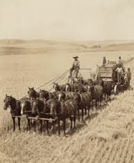
Horse-drawn
“Combine Harvester”
  Collaboration was the realistic approach.
  “Fierce independence” was the unrealistic approach
  The camaraderie in the fields and the multi-family harvest celebration at the farmhouse were things of Social Beauty

Slide 81
Full grown wheat does not magically appear overnight
Prepare the field
Sow the seeds
Water
Sunlight
Hard work…Collaboration
Continually learn
Protect the soil
Social Beauty does not magically appear overnight
Prepare fertile ground
Sow the seeds…
Water…
Shine light …

Slide 82
Thank you!
For your attention and for
your interest in
Sowing Seeds of Social Beauty
and
Shining light on that which has been kept in the dark
Rob Rennebohm, MD Email: rmrennebohm@gmail.com Website: www.notesfromthesocialclinic.org

