Slide 1
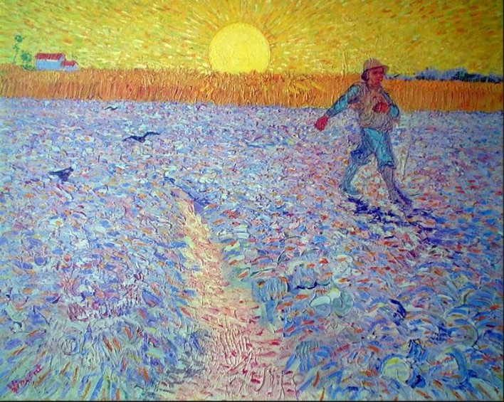
Sowing Seeds of Social Beauty
A Course About:
The Untold Story of the Children’s Hospital Public Economy Model (CHPEM)
And
The Development of
Social Clinicians
Presentation 2:
Social Beauty

Slide 2
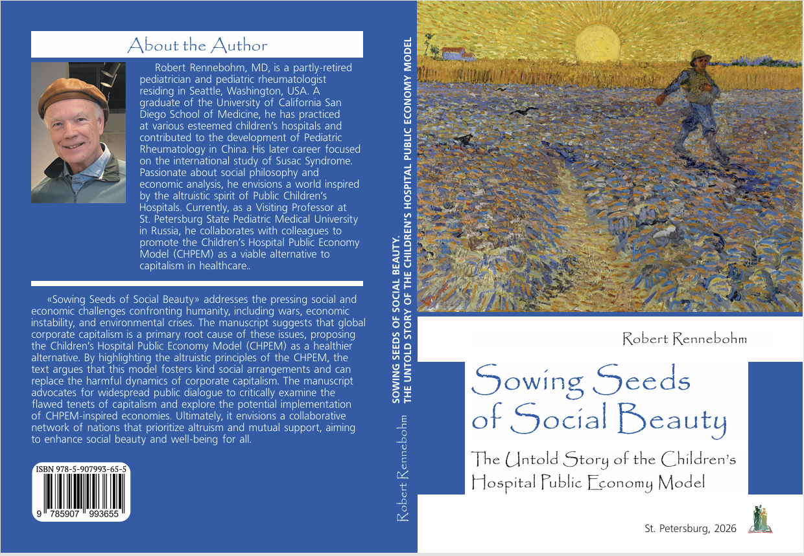

Slide 3
Social Beauty
What does this phrase mean?
Where did this phrase come from?
Have you ever heard of this phrase before?
What does it mean that the phrase “Social Beauty” is not part of the lexicon of our culture?

Slide 4
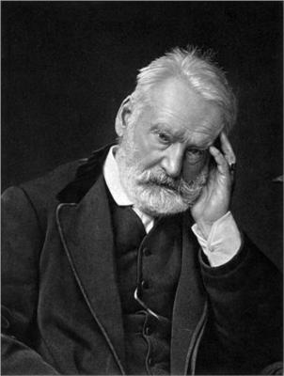

The phrase “Social Beauty”
It comes from the novel
Les Miserables
Written by Victor Hugo
In 1862
Translated by Charles Wilbour
In 1862
1802-1885
1862
Notes:
.

Slide 5
A Definition of Social Beauty
Social Beauty refers to any social arrangement, social activity, or social behavior that, when witnessed or experienced, warmly touches the human heart, uplifts the human spirit, reminds us of the best behavioral capacities of our human nature (e.g., our capacities for empathy, compassion, altruism, kindness, and creativity), elevates feelings of gratitude for Life and each other (including gratitude for opportunities to contribute to the well-being of others), and makes one proud to be a part of Humanity.
Social Beauty is the product of Kind Social Arrangements (and the social activities and social behaviors generated by those arrangements) and those Kind Social Arrangements are, themselves, things of Social Beauty.

Slide 6
Definition of Social Atrocity
Social Atrocity, the opposite of Social Beauty, refers to any social arrangement, social activity, or social behavior that, when witnessed or experienced, sickens the heart, crushes the human soul, and dampens the human spirit. Social Atrocity reminds us of the most unkind capacities of our human nature---e.g., our capacities to be mean, uncaring, greedy, ungrateful, and even violent. Social atrocity is the result of Mean Social Arrangements (and the harmful social activities and behaviors those mean arrangements create) and those Mean Social Arrangements are, themselves, Social Atrocities.

Slide 7
The Kind Social Arrangements that create Social Beauty are reflections of a deep love and respect for Humanity and the Earth, and these arrangements beget even deeper and more practiced love and respect. These kind arrangements enable, encourage, and give practice to escalating levels of individual and collective kindness.

Slide 8
The Mean Social Arrangements that create Social Atrocities are reflections of an absence of deep love and respect for Humanity and the Earth, and these arrangements beget even deeper and more practiced disregard and disrespect for Humanity and the Earth. These Mean Arrangements enable, encourage, and give practice to escalating levels of individual and collective unkindness.

Slide 9
The Kind Social Arrangements and the social activities and other effects generated by those arrangements move our hearts and minds via the senses and emotions, as well as intellectually.
Like beautiful music, great visual art, and Nature’s Beauty, Social Beauty touches and stirs our humanity. Kind Social Arrangements and the Social Beauty created by them awaken, motivate, and liberate. They address profound social longings, deepen the meaningfulness of life, provide clarity, enliven imagination and conscience, and give us confidence in ourselves and in the goodness of Humanity. These kind arrangements and associated activities transform people, individually and collectively, as all increasingly participate in the creation of ever-more Social Beauty.

Slide 10
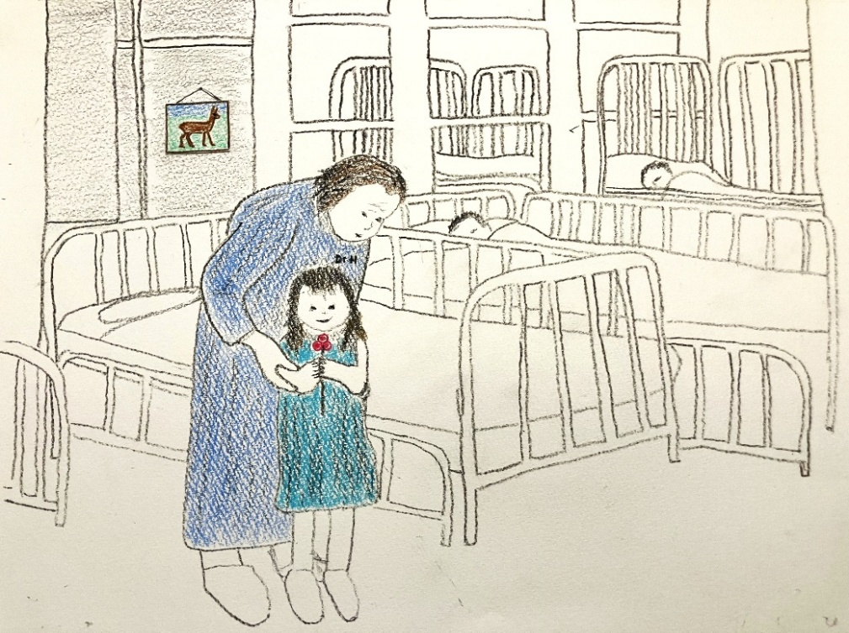
A Scene of Social Beauty:
Dr. H congratulating her patient’s successful conquering of leukemia
at a Public Children’s Hospital

Slide 11
The opposite of Kind Social Arrangements are Mean Social Arrangements that dehumanize us, seduce us, exploit us, oppress us, demoralize us, and alienate us, individually and collectively.

Slide 12
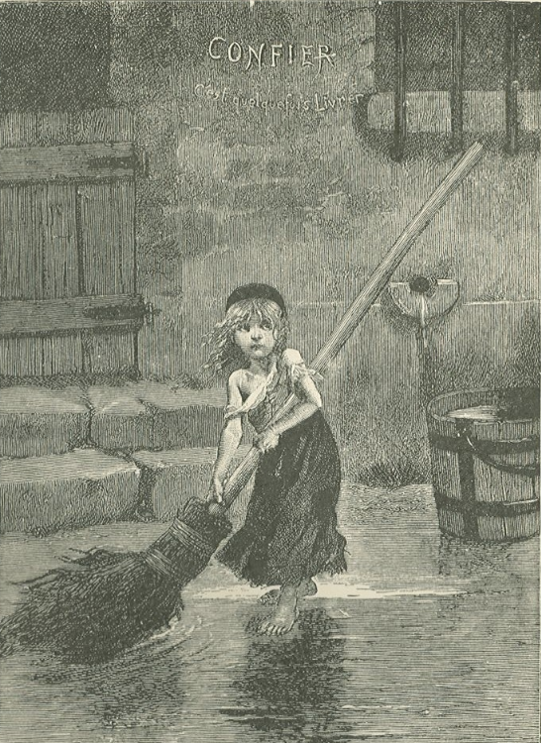
Cosette’s wretched life under the abusive rule of the Thenardiers
Victor Hugo’s
Les Miserables

Slide 13
An Example of Kind Social Arrangements and Social Beauty
A mother brings her sick child to a Public Children’s Hospital:
  She knows she will not be charged a fee for care provided
  Child receives compassionate, unrushed, expert care
  Flute concert performed by 20 children who learned to play through a Public Arts Program
  Grateful embrace of hospital worker at discharge
  The dedication, altruism, and expertise of the entire hospital staff
  All of these are “things of Social Beauty” that, when witnessed or experienced warmly touch the human heart and uplift the human spirit.

Slide 14
Example of Mean Social Arrangements and Social Atrocity
An ill 50-year-old man with limited financial resources and no health insurance hesitates to go to the medical clinic.
Callous, uncaring, heartless reception at clinic.
Man dies from lack of health care
These are Mean Social Arrangements that result in Social Atrocity

Slide 15


Slide 16


Slide 17


Slide 18
Nature’s Beauty, including its scents and sounds, uplifts our spirits, inspires us, and fills us with deep gratitude for not only the privilege to be Nature’s guest but also the privilege of Life itself. Such are the powerful positive effects that Nature’s Beauty has on the senses, emotions, thoughts, and beliefs of a human.
Similarly, Social Beauty, when witnessed or experienced, has powerful positive effects that uplift and inspire us and elevate feelings of gratitude for Life and each other.

Slide 19
What does it say about our society that a phrase like “Social Beauty” is not part of our lexicon?

Slide 20
It shows the extent to which our attention has been focused on the negative aspects of our Human Nature and the Mean Social Arrangements and Social Atrocities that a small and undeservedly powerful percentage of human beings has created, as if these are the primary characteristics and inclinations of Humanity as a whole and will always prevail.
It shows the extent to which our attention has been turned away from the positive aspects of our Human Nature and our potential to create Kind Social Arrangements and Social Beauty, as if those aspects and that potential are negligible and the goal of creating greater Social Beauty is unrealistic and even dangerous.

Slide 21
What does “Sowing Seeds of Social Beauty” mean?
Choosing “kernels of truth”
Preparing fertile soil
Planting seeds that will blossom into expressions of the best aspects of our human nature
Imagining “Vast Fields of Public Activity”
Promoting and cultivating healthy dialogue
Shedding light on that which has been kept in the dark

Slide 22
What does “Sowing Seeds of Social Beauty” mean?
Helping new, better understandings to grow
Widely distributing those new understandings
Offering them for consideration
Being farmers who produce the ingredients for an abundance of Social Beauty
That is what “Sowing Seeds of Social Beauty” means

Slide 23
Thank you
for your attention
and for
your interest in Sowing Seeds of Social Beauty

