Slide 1
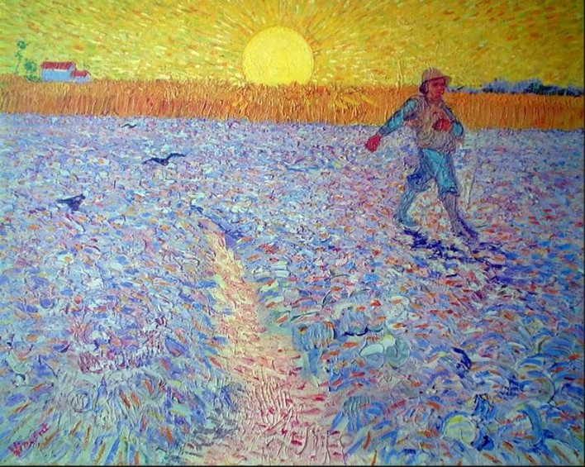
Sowing Seeds of Social Beauty
A Course About:
The Untold Story of the Children’s Hospital Public Economy Model (CHPEM)
And
The Development of
Social Clinicians
Presentation 3:
The Children’s Hospital Public Economy Model

Slide 2


Slide 3
The Children’s Hospital Public Economy Model (CHPEM)
How and why Public Children’s Hospitals came into being.
How they were initially organized, operated, and funded.
What the culture was like.
What the guiding social understandings and behavioral principles were.
How the CHPEM generated great Social Beauty.

Slide 4
The Children’s Hospital
Public Economy Model (CHPEM)
Since the 1950s, Academic Pediatricians throughout the world have practiced an altruistic Public Economy Model---the Children’s Hospital Public Economy Model (CHPEM) or Children’s Hospital Model, for short---and have developed a loose, informal Collaborative International Network of Pediatricians and Public Children’s Hospitals that practice the CHPEM.

Slide 5
This model resulted in great Social Beauty within children’s hospitals.
The model was developed in exemplary fashion in Canada

Slide 6
The CHPEM is a “needs-based” model. It starts with the question: “What do children need?”
What is the best way to organize the needs-meeting effort?
  Each large metropolitan area needed a medical school-affiliated publicly-funded children’s hospital
    In Alberta, there are 2 large metropolitan areas and, therefore, 2 publicly-funded medical schools and 2 publicly-funded children’s hospitals
  Develop a Collaborative National Network of publicly-funded provincial children’s hospitals

Slide 7
Characteristics of the CHPEM
Cost-based
Budget-based,
Altruistic
Moral incentive, not Monetary Incentive
Altruistic natural leaders
Appropriate budget, based on appropriate costs
Appropriate salaries, appropriate work loads, appropriate efficiency
No fee-for-service billing
Altruistic spirit and work ethic
“The highest Duty is to think of others”

Slide 8
The Set of Foundational Social Understandings Upon Which the CHPEM is based
A positive, nuanced understanding of Human Nature.
Moral incentive is a sufficient motivating factor and is preferable to monetary incentive.
Altruistic natural leaders.
An accurate understanding of competition.
A most precious Freedom

Slide 9
The Set of Foundational Social Understandings Upon Which Corporate Capitalism is based
A negative, incomplete, and inaccurate understanding of Human Nature.
An insistence that Monetary incentive is a necessary motivating factor.
Leaders are chosen who will be best able to increase the financial bottom line.
An inaccurate and detrimental understanding of competition.
Individual liberty and optimal opportunity to pursue one’s own self-interest are the most important freedoms.

Slide 10
The Canadian Collaborative National Network of Public Children’s Hospitals
Collaborate and coordinate to improve care for children.
The children’s hospitals help each other to become better.
Regularly scheduled conferences to freely share expertise and new knowledge.
No “intellectual property rights.”
Health care and health information are human rights.
Each hospital also participates in a Collaborative International Network of Pediatricians and Children’s Hospitals

Slide 11
Commitment to Fundamental Principles of Science, Medicine, Ethics, and Democracy
Data must be collected in an honest, scientifically sound fashion.
Data must be honestly presented and honestly explained.
Root cause must be sought.
All plausible hypotheses must be honored and considered
Thorough patient education must be offered.
Demystification is a key to good clinical practice
Proper provision of informed consent

Slide 12
This same needs-based, cost-based, budget-based, science-based, altruistic, collaborative economic model has been practiced by academic pediatricians in public children’s hospitals throughout the world for decades, to the great benefit of the world’s children.

Slide 13
The Creativity, Innovation, and Efficiency of the CHPEM
The Childhood Cancer Study Group (CSG)--a multi-center collaborative clinical research effort.
In the early 1970s the mortality rate for Acute Lymphocytic Leukemia (ALL) was 90%
By the 1990s the mortality rate for ALL was less than 10%
The knowledge gained has been freely shared with pediatric hematologists/oncologists throughout the world

Slide 14
With the CHPEM each individual children’s hospital is independent and is encouraged to develop in its own creative way, according to its unique local conditions.
Although the CHPEM strongly encourages collaboration, there is no central authority that dictates how all members of the network are to think, operate, or behave.
Although there is no central authority, there is a strong central unifying spirit---the altruistic spirit and the specific underlying philosophical principles of the CHPEM, including its commitment to honoring the fundamental principles of Science, Medicine, Ethics, and Democracy.

Slide 15
So, for decades, Academic Pediatricians, particularly in Canada, have demonstrated the success and value of the CHPEM, including the feasibility and value of developing a Collaborative National Network of Public Children’s Hospitals, and a Collaborative International Network of National Public Children’s Hospitals.
This model (the CHPEM) has not simply been developed in theory, it has actually been practiced, for decades, and has already proven to be of great benefit to the world’s children, at an affordable price for societies.

Slide 16
The vast majority of Academic Pediatricians have found this Academic Pediatrics Economic Model (the CHPEM) to be very meaningful, gratifying, and emancipating.
They appreciate the opportunity and freedom it provides to enjoy expressing altruistic capacities---individually and collectively. They have enjoyed the freedom to plan and act altruistically. They have treasured this “most precious freedom.”

Slide 17
Unfortunately, over the past 30 years, or so, children’s hospitals, including those in Canada, have become increasingly corporatized, at the administrative level, particularly in the USA.
This corporatization has brought a new leadership model to many children’s hospitals. Altruistic natural leaders have been replaced by corporate-minded leaders.
Monetary incentive, revenue generation, maximization of fee-for-service billing, cut-throat competition, empire-building, and other corporate behaviors and priorities have been emphasized and have replaced altruistic goals and behaviors.

Slide 18
The “Social Beauty Era”
(the “Altruistic Era” or the “CHPEM Era”)
1955-1995
The “Corporate Era”
1995-present

Slide 19
For decades academic pediatricians, especially in Canada, experienced the proven value and success of the CHPEM, during the Altruistic Era.
More recently, they have also experienced the adverse effects of the corporatization of children’s hospitals, during the Corporate Era.

Slide 20
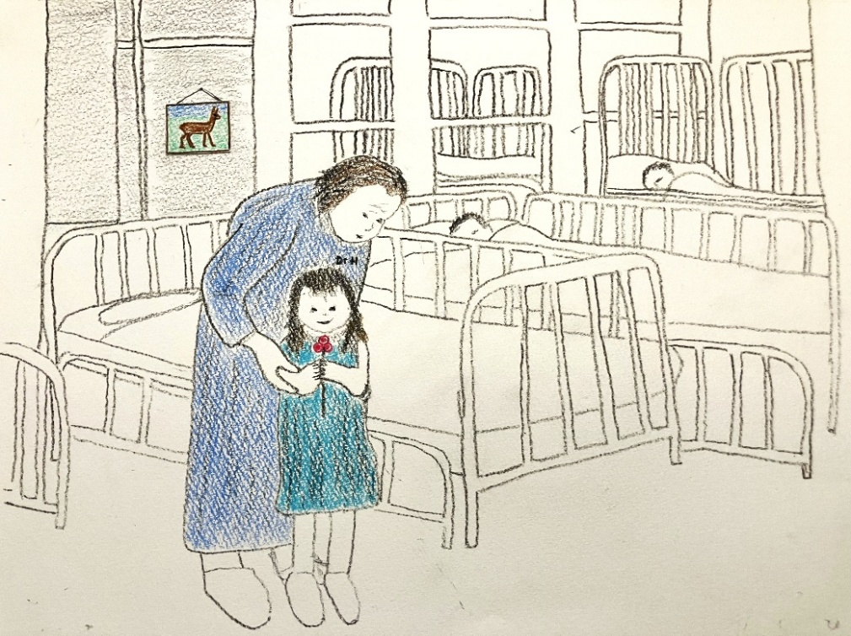
During the
“Altruistic Era”
the CHPEM created Kind Social Arrangements and Social Beauty
During the “Corporate Era” those outcomes have been compromised
It is time to reverse the corporate trend

