Slide 1
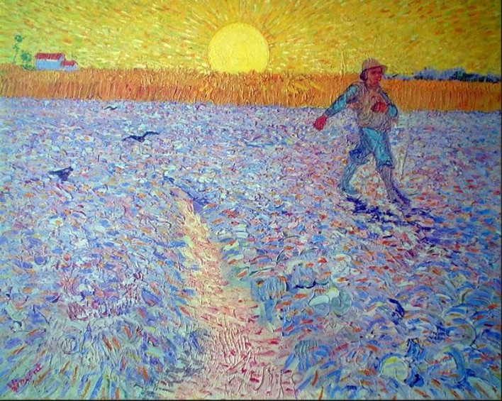
Sowing Seeds of Social Beauty
Presentation 4
The Social, Moral, Economic, and Political Philosophy of Victor Hugo
Notes:
This presentation serves as an introduction to a course entitled Sowing Seeds of Social Beauty: The Untold Story of the Children’s Hospital Public Economy Model (CHPEM)

Slide 2
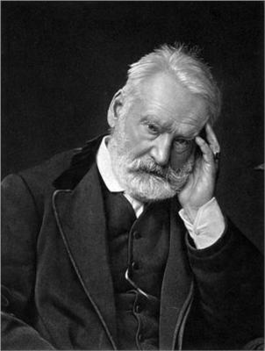

The Social, Moral, Economic, and Political Philosophy of Victor Hugo
Victor Hugo was a Social Clinician who believed in the imperishability and grandeur of the human soul. He sought root cause and offered uplifting analysis and brilliant remedy.
1802-1885
1862
Notes:
A common theme of the course is that the CHPEM is consistent with Victor Hugo’s social, moral, economic, and political philosophy and vision for society. Indeed, the CHPEM could also be called a Hugoist social and economic model.

Slide 3
The Philosophy of Victor Hugo
Positive view of Human Nature
He believed Humanity had great potential to create Social Beauty
He had enormous compassion for all living things, especially the most vulnerable.
He believed strongly in creating “vast fields of public activity.”
He believed in public economy.
He was conservative, liberal, radical, progressive, and revolutionary---all at the same time. No one label did justice to his philosophy.

Slide 4
Excerpts from Les Miserables
“The highest duty is to think of others; the highest justice is conscience.”
“An awakening of conscience is greatness of soul.”
“The study of social deformities and infirmities, and their indication in order to cure them, is not a work in which choice is permissible.”

Slide 5
“We seek for the cause. We must ponder over social questions: wages, education, misery, production, and distribution.”
“We must create vast fields of Public Activity, to have a hundred hands to stretch out to the exhausted and feeble, to employ the collective power in the great duty of opening workshops for all arms, schools for all aptitudes, and laboratories for all intelligence.”
“If labour is to be law, it must also be a right.”

Slide 6
“We must create wise wealth and distribute it equitably---not equal distribution, but equitable distribution. If liberty is the summit, equality is the base. Equality, though, is not all vegetation on a level---a society of big spears of grass and little oak trees.
“To destroy abuses is not enough; habits must change.”

Slide 7
“When one looks at the selfish and the miserable, the ideal [of Social Beauty] seems lost in the depths---shining, but isolated and imperceptible.
In the selfish one sees the prejudices, the darkness of the education of wealth, appetite increasing through intoxication, a stupefaction of prosperity which deafens, a dread of suffering which, with some, is carried even to an aversion for sufferers, an implacable satisfaction, the me so puffed up that it closes the soul.

Slide 8
“In the miserable one sees hearts of gloom, sadness, want, fatality, ignorance impure and simple, and, with some, covetousness, envy, and hatred.
And yet, this ideal [of Social Beauty], seemingly so lost, is in no more danger than a star in the jaws of a cloud.”

Slide 9
“People who are petrified in dogma or demoralized by lucre are unfit to lead Civilization. Genuflexion before the idol or the dollar atrophies the muscle which walks and the will which goes. Hierarchic or mercantile absorption diminishes the radiance of a people, lowers its horizon by lowering its level, and deprives it of the intelligence of the universal aim.”

Slide 10
“Auscultation of civilization is encouraging. Progress is the mode of man. The general life of the human race is called Progress. He who despairs is wrong. Grief everywhere is only an occasion for good always.”
Remember though, “To love is to act.” We must act.
“Progress is the aim; the ideal is the model.”

Slide 11
“But what about a compromise? There does exist an entire political school called the compromise school. Between cold water and warm water there is tepid water. This school with its pretended depth, wholly superficial, which dissects effect without going back to causes, from the height of half science, chides those who agitate for change. These almost people content themselves with their almost wisdom.”

Slide 12
“Change should be civilized. No abrupt fall is necessary. Neither despotism nor terrorism should be tolerated. The healers must remain innocent. Progress with gentle slope is desirable.”
“Someday we will be astounded. There is no more a backward flow of ideas than a backward flow of a river.”

Slide 13
The Hugoist Social and Economic Model
Both the kindest, most altruistic capitalists
and the kindest, most altruistic socialists might find the Hugoist model to be most consistent with their most cherished beliefs, principles, values, goals, and preferred behaviors.
Perhaps, the Hugoist model represents a “Third Way.”
Notes:
We will point out that both the kindest, most altruistic capitalists and the kindest, most altruistic socialists might find the Hugoist model to be most consistent with their beliefs, principles, values, and goals. Perhaps, the Hugoist model represents a “Third Way.”

Slide 14
Les Miserables is full of these and many other indications of Victor Hugo’s social, moral, economic, political, and spiritual philosophy.
The writing of Sowing Seeds of Social Beauty has been informed and inspired by Victor Hugo’s thinking.
Indeed, the phrases “Social Beauty,” “Social Clinic,” “Vast Fields of Public Activity,” and “Mean Arrangements of Man” (which I call Mean Social Arrangements) came from Les Miserables.

Slide 15
For more information about Victor Hugo, see the following chapters in Sowing Seeds of Social Beauty:
Chapter 1: Create Vast Fields of Public Activity—Excerpts from Les Miserables
Chapter 2: Nature’s Garden—Model for a Healthy Human Social Ecosystem

