Slide 1
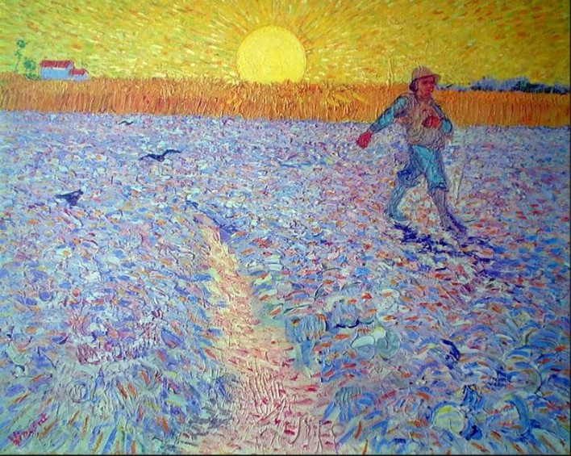
Sowing Seeds of Social Beauty
Presentation 10:
Perspectives on
Freedom

Slide 2
A Most Precious Freedom
One of the most precious freedoms is the freedom that comes from participating in comprehensive public efforts to genuinely look after others:
The freedom to enjoy widespread up-regulated expressions of the human capacity for kindness--in oneself and in the larger society, expressions that are inter-dependent.
This freedom is generated by social arrangements and social activities that create Social Beauty.

Slide 3
Those of us who worked in children’s hospitals during the “Social Beauty Era” enjoyed an abundance of this freedom. This type of freedom is quite spotty and largely denied in societies dominated by corporate capitalism.
Indeed, this freedom was markedly compromised in children’s hospitals when the corporate capitalist model replaced the CHPEM—i.e., during the “Corporate Era” of children’s hospitals

Slide 4
According to the corporate capitalist perspective, individual liberty and the freedom to maximally pursue one’s self-interest (unimpeded by “big government”) are the most precious freedoms, as is “freedom of choice.”
The CHPEM agrees that Individual liberty, freedom to pursue one’s self-interest, and freedom of choice are certainly important and must be protected.

Slide 5
But what is often overlooked is that aggressive pursuit of one’s self-interest (or a corporation’s self-interest) can result in the trampling of the freedom of others. There is no better example of this than the story of cobalt mining in the Congo that is discussed in Presentations 1 and 11.
The private mining corporations felt entitled to their freedom to exploit natural resources in the Congo; they did not want that freedom to be constrained by government regulations; and they ignored the fact that the exercise of their freedom trampled on the freedom of children to be children and enjoy a healthy childhood.

Slide 6
The CHPEM suggests that pursuit of individual liberty and pursuit of self-interest should not occur at the expense of others and should not occur at the expense of “a most precious freedom.”
The CHPEM is designed such that “a most precious freedom,” individual liberty, freedom to pursue one’s self-interest, and freedom of choice can co-exist in a healthy balance. That is, all four of these freedoms are valued, provided, and protected.
The corporate capitalist model values, provides, and protects only two of these four freedoms and does so only for some (a small minority), at the expense of others (the majority).

Slide 7
Most people are yearning for this “most precious freedom.” When the aware seek it in a culture dominated by capitalism, they have difficulty finding it, because the capitalist economic model and the culture that model creates do not provide this most precious freedom and hide the path towards it.
That is, the Corporate Capitalist model does not offer the choice of “a most precious freedom.” Despite claiming to believe in “freedom of choice,” it does not provide that choice, that type of freedom.
People would have experienced this most precious freedom if they had worked in a children’s hospital during the “Social Beauty Era.”

Slide 8
To Summarize:
Freedoms must be valued, provided and protected.
These freedoms include individual liberty, freedom to pursue one’s self-interest, freedom of choice, and “a most precious freedom.”
These four freedoms must be equitably available to all and be exercised in a healthy balance.
The CHPEM provides and protects all four of these freedoms, for all, and in a healthy balance.
The corporate capitalist model provides only the first two of these freedoms, only for some, and does so in an unbalanced way at the expense of the other two freedoms and at the expense of others.

Slide 9
Sowing Seeds of Social Beauty
Thank you
for your attention
and for
your interest in
Sowing Seeds of Social Beauty
Notes:
This presentation serves as an introduction to a course entitled Sowing Seeds of Social Beauty: The Untold Story of the Children’s Hospital Public Economy Model (CHPEM)

