Slide 1
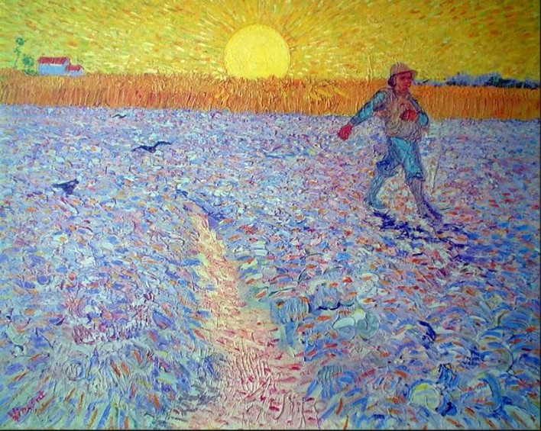
Sowing Seeds of Social Beauty
Presentation 12:
The Achilles’ Heel
Of Capitalism

Slide 2
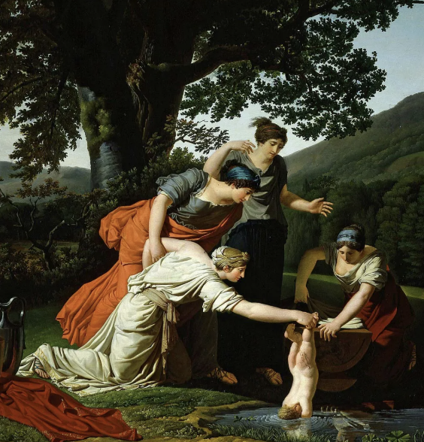
Meaning:
A person’s (or an institution’s or belief system’s) weak spot.
Achille’s Heel
Greek Myth:
Achilles was a Greek hero whose mother Thetis was a sea goddess. When Achilles was born, Thetis received a prophecy (a prediction) that he was destined to die young. To protect him, she dipped him, when he was a baby, into the River Styx, because waters from this river were thought to make humans invincible.
However, she held him by the heel, thus leaving a vulnerable area.

Slide 3

Achilles’ Heel
Achilles would later die, as prophesied.
He died by an arrow to his (Achilles’) heel, the only place where he was vulnerable.
This presentation explains where Capitalism is most vulnerable.
It explains Capitalism’s Achilles’ Heel---Capitalism’s weak spot---How the true nature and harm of Capitalism can be most effectively exposed and understood.

Slide 4
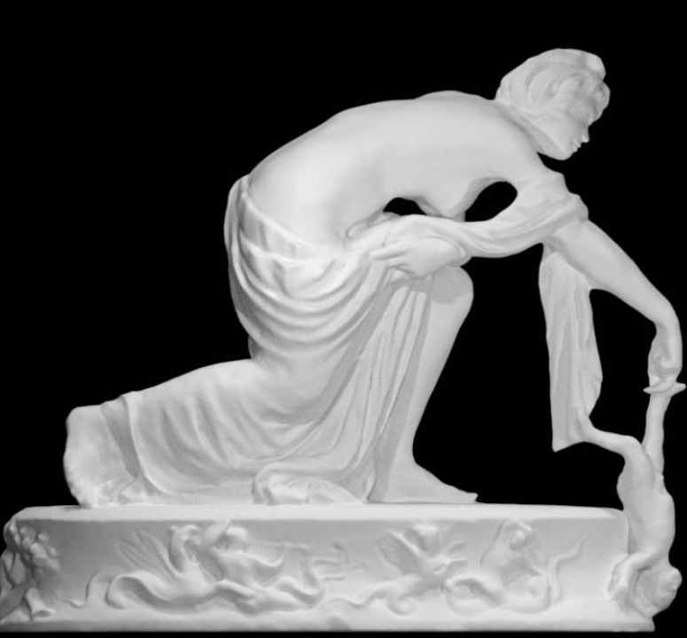
The capitalist era dates from the 16th century (approximately 500 years ago). Since then, capitalism has become increasingly dominant, globally, particularly over the past 300 years.
Currently, global corporate capitalism is more powerful than ever, despite spawning countless “Mean Social Arrangements” and “Social Atrocities.”
How has capitalism been able to maintain its dominance for so long?
Where is the capitalist argument weakest, most vulnerable?
What is capitalism’s Achilles’ Heel?

Slide 5
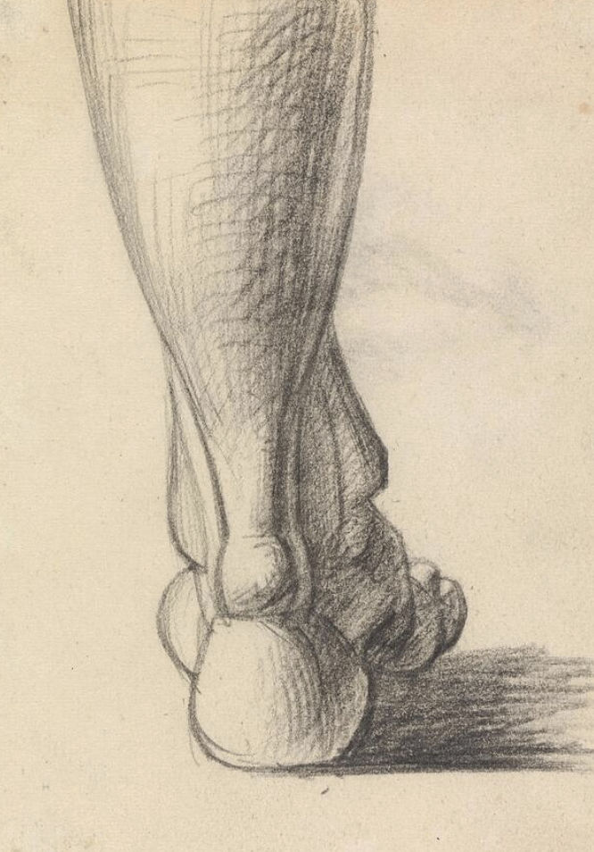
It is the contention of this Course that global corporate capitalism has been able to survive and increasingly dominate for several centuries because the set of social understandings upon which it is based has not been adequately challenged.
Proponents of capitalism have been able to convince themselves and most of the public that this set of social understandings (which, in my view, are misunderstandings) is accurate.

Slide 6

The corporate capitalist model is based on and promotes the following set of social (mis)understandings:
A negative, simplistic, incomplete, inaccurate, abusive, anti-human (mis)understanding of Human Nature---one that excessively emphasizes our capacity for self-interest seeking and claims that selfishness is the dominant behavioral capacity of human beings.
Worse, corporate capitalism ignores how a chosen economic model can upregulate expression of our non-altruistic behavioral capacities and downregulate expression of our altruistic capacities (as is the case with corporate capitalism) or can upregulate expression of our altruistic capacities and downregulate expression of our non-altruistic capacities (as is the case with the Children’s Hospital Public Economy Model, CHPEM).

Slide 7
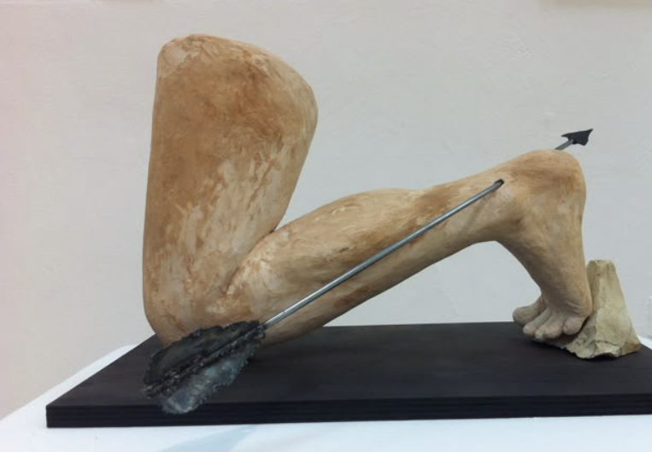
An insistence that “monetary incentive” is the “sine qua non” of any successful economic model---because “due to (their view of) human nature,” people need monetary incentive for adequate motivation and adequate performance.
A negative, simplistic, inaccurate, and perverse understanding of the nature and role of competition.
An insistence that monetary incentive and capitalism’s perverted version of competition are essential for innovation and creative advancements.

Slide 8
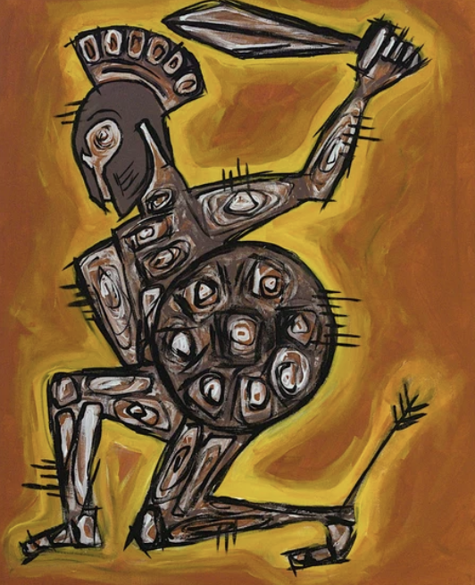
A belief that private free enterprise and free market activity are the most essential components of any successful social and economic model.
A belief that capitalism, despite its many flaws, is the best economic model that has ever been created---because it considers the above understandings (the purported “realities” of human nature, etc.) and because alternative models “do not sufficiently take the above ‘realities’ into account and inevitably lead to authoritarian, totalitarian behaviors and failure.”
A belief that the best leaders are those who most enthusiastically embrace, practice, and promote the above set of social understandings.

Slide 9
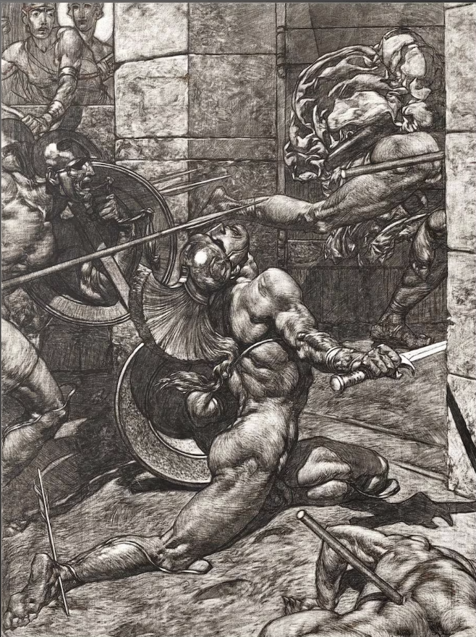
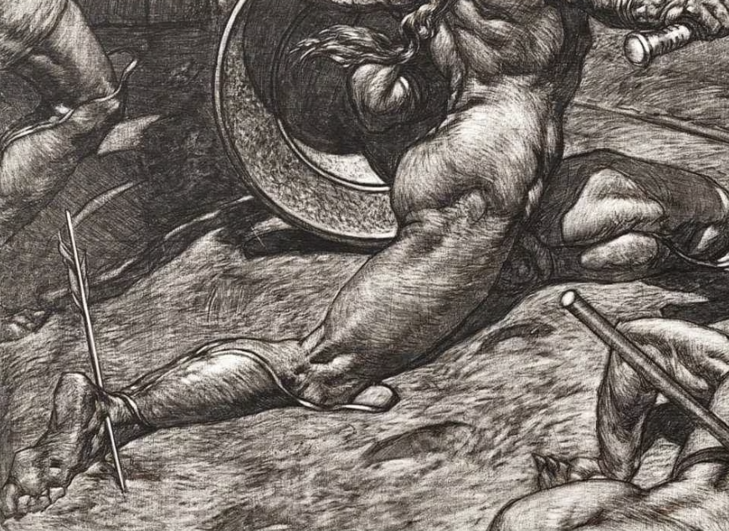
It is the contention of this
Course that the above set of
social understandings
represent powerfully misleading misunderstandings.
In stark contrast, the Children’s Hospital Public Economy Model (CHPEM) is based upon the following set of social understandings:

Slide 10
The Set of Social Understandings Upon Which the CHPEM is Based
A positive, comprehensive, more nuanced understanding of Human Nature that emphasizes the spectrum of human behavioral capacities that we all have (including capacities for both altruistic behaviors and non-altruistic behaviors) and emphasizes that the social and economic model that a society chooses can either upregulate or downregulate expression of given capacities.
An understanding that “moral incentive” is a sufficient motivating factor and that “monetary incentive” is neither essential nor desirable.

Slide 11
A positive, accurate understanding of the true nature and role of “competition,” particularly the understanding that the word “competition” comes from the Latin “com petere,” which means “to seek (new heights) together.
A realization that “monetary incentive” and capitalism’s version of competition are not necessary for innovation and creativity.

Slide 12
A realization that private free enterprise and free market activity are not essential for a successful social and economic model. Instead, a different kind of freedom might be the most precious freedom of all---the freedom to enjoy widespread upregulation of the expression of human altruistic behavioral capacities---upregulation in oneself and in society as a whole (which are inter-dependent). This “precious freedom” is provided by a public economy, but not by a capitalist economy.
A realization that it is best to fill positions of leadership in society and the economy with “altruistic natural leaders” who have demonstrated exemplary altruism, honesty, kindness, and incorruptibility---as opposed to filling positions of leadership with those who will make corporate entities most profitable.

Slide 13
A recognition that it is unrealistic to think the “Mean Social Arrangements” that are currently harming Humanity and the Earth can be corrected by continuing the economic model that has spawned and exacerbated these problems in the first place.
The most realistic way to correct these Mean Social Arrangements is to develop “Kind Social Arrangements” that spawn Social Beauty rather than Social Atrocity and Social Misery. The CHPEM creates and supports kind social arrangements and spawns Social Beauty.

Slide 14

Most people (at least in the USA) have accepted the negative and incomplete understanding of Human Nature that has been incessantly taught by the corporate capitalist economic model.
Most people have not been introduced to the positive, more complete and more accurate understanding of Human Nature upon which the CHPEM is based.
Most people have also accepted the notion that “monetary incentive” is essential for motivation, excellent performance, and innovation, and have not considered that “moral incentive” can be an adequate motivating factor.

Slide 15

Most people have been taught a negative and rather perverted understanding of the nature and role of “competition.”
Most have never heard of “altruistic natural leaders.”
Most have never considered the existence of, much less the importance of, “a most Precious freedom.”
Most have never heard of “Social Beauty” or the concept of “Social Clinic.” Most have rarely, if ever, thought of “vast fields of public activity” and a “Public Economy,” and when/if they have, it is a thought that, due to their education to date, reflexively strikes fear of totalitarianism and loss of individual liberty.

Slide 16

Most have been taught that capitalism, despite its flaws, is the best, most “realistic,” and most successful economic model ever implemented, and that alternative models, particularly public economy models, are inferior, “always lead to disastrous results,” should be feared, and should not be considered.
Most people have not worked extensively in an altruistic children’s hospital, or a similarly altruistic setting---which means they might have little personal experience with collaborative, altruistic, non-profiteering efforts that practice the foundational set of social understandings upon which the CHPEM is based.

Slide 17
In short, pro-capitalist teachings (which amount to propaganda) have been extraordinarily powerful and effective. That propaganda has convinced people that no alternative economic models need to be considered.
Worse, the message has been that alternative economic models are dangerous to even think about.
This pro-capitalist propaganda has immunized people against consideration of any alternative models. That has made it difficult for people to understand “Social Beauty,” the CHPEM, and application of a CHPEM-inspired/Hugo-inspired Public Economy Model to the general economy.
Pro-capitalist propaganda has been so powerful that most people are hesitant to even read about these alternative ideas. Unfortunately, this pro-capitalist propaganda has not been adequately or effectively challenged.

Slide 18
What has been least recognized is that the foundational set of social (mis)understandings upon which corporate capitalism is based (those listed earlier), which have given capitalism its great power and control over Humanity, is also its Achilles’ heel (i.e., where it is most vulnerable),
and the most effective way to hold corporate capitalism to account and reverse its harmful effects on society is to expose the inaccuracies and flaws of its foundational (mis)understandings
and explain how the foundational pillars of the CHPEM represent a more accurate and helpful understanding of Human Nature and how to organize and conduct a society.

Slide 19

In other words, we should expose how proponents of corporate capitalism have been (wittingly or unwittingly) gaslighting the public with its (capitalism’s) set of social understandings.
It cannot be emphasized enough how extremely powerful, effective, controlling, and abusive the pro-capitalist, anti-public, anti-Humanity propaganda has been.
It is not enough to just treat the symptoms of corporate capitalism. The roots of corporate capitalism’s power and control over Humanity (its foundational set of social misunderstandings) must be effectively challenged.

Slide 20
Corporate capitalism is not threatened by mere symptomatic treatment of the problems it creates.
Symptomatic treatment (e.g., softening or partial correction of its “Mean Social Arrangements”) gives the illusion of a somewhat “kinder and gentler” form of capitalism and gives the illusion of progress
but symptomatic treatment does not affect the root cause of capitalism’s power and control or its ability to cleverly adjust in order to continue infecting and dominating.
Lethal viruses and malignancies cleverly adjust in order to continue infecting and dominating. So, too, does corporate capitalism.

Slide 21
In fact, symptomatic treatment of capitalism without accompanying exposure and correction of its foundational set of social misunderstandings enables capitalism to continue its dominance
because such treatment gives the false impression that capitalism is okay as long as it is made kinder and gentler via better regulation and periodic injections of compassion.
That is why capitalism is not threatened by symptomatic treatment. In fact, that symptomatic treatment makes capitalism more palatable and thereby enhances its ability to survive and continue dominating.

Slide 22
Therefore, in addition to treating the symptoms of corporate capitalism, we must focus on corporate capitalism’s Achilles’ heel---its inaccurate, powerfully misguiding foundational set of social (mis)understandings.
That is where the corporate capitalist model is most vulnerable and would feel most threatened. Throughout the past several centuries, the corporate capitalist social and economic model has been able to infect, thrive and dominate because its foundational set of social (mis)understandings has not been sufficiently exposed and challenged.

Slide 23
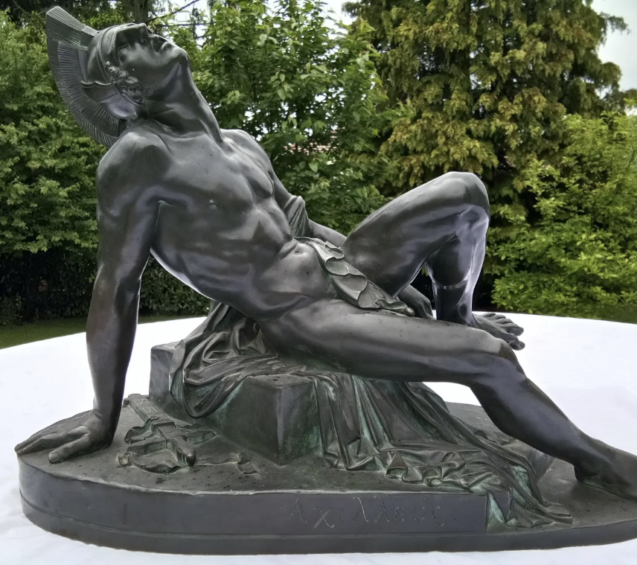
Accordingly, the most realistic way to free Humanity from corporate capitalism’s predatory grip is to focus on capitalism’s Achilles’ heel.

Slide 24
Sowing Seeds of Social Beauty
Thank you
for your attention
and for
your interest in
Sowing Seeds of Social Beauty
Notes:
This presentation serves as an introduction to a course entitled Sowing Seeds of Social Beauty: The Untold Story of the Children’s Hospital Public Economy Model (CHPEM)

