Slide 1
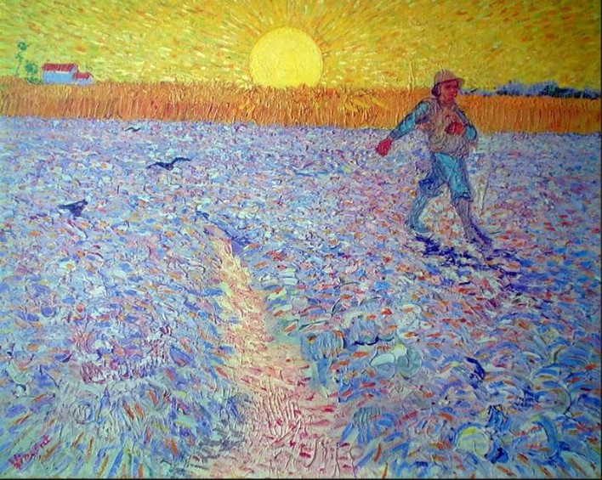
Sowing Seeds of Social Beauty
Presentation 5
Foundational Social Understandings
Notes:
This presentation serves as an introduction to a course entitled Sowing Seeds of Social Beauty: The Untold Story of the Children’s Hospital Public Economy Model (CHPEM)

Slide 2
The set of social understandings upon which the CHPEM is based is completely different from the set of social understandings (and I would say misunderstandings) upon which capitalism is based.
Kind Social Arrangements
The set of social understandings upon which the CHPEM is based yields
Social Beauty
The (flawed) set of social understandings upon which capitalism is based yields
Mean Social Arrangements
Social Atrocity

Slide 3
Foundational Set of Social Understandings
Regarding:
  Human Nature
  Leadership
  Motivation and Incentive
  Competition
  Freedom

Slide 4
Human Nature
The CHPEM is based on a positive, nuanced, complex, pro-human understanding of human nature.
While acknowledging that all of us have both altruistic and non-altruistic behavioral capacities within our individual human natures, the CHPEM seeks to emphasize and optimally upregulate expression of our altruistic capacities rather than our non-altruistic capacities.

Slide 5
Human Nature
Capitalism is based on and promotes a very negative, simplistic, and incomplete view of human nature---one that excessively emphasizes the non-altruistic capacities of our human nature and inevitably upregulates expression of those capacities.
While the CHPEM encourages faith in Human Goodness, the capitalist model discourages faith in Human Goodness and gives the message that human beings are primarily selfish and rather hopelessly so.

Slide 6
Human Nature and the Social Milieu
While the CHM emphasizes that the social milieu can upregulate or downregulate expression of given capacities of our human nature (individually and collectively), the capitalist model largely ignores the effect of the social milieu on expression of the various capacities of our Human Nature.

Slide 7
“Gaslighting” the Public Regarding Human Nature
If capitalism can convince most of the public that capitalism’s view of human nature is correct, then the public will accept capitalism’s argument that capitalism is the best possible and most realistic economic model because it considers that human beings are primarily selfish and that faith in human goodness gives Humanity too much credit. Capitalism depends on public acceptance of capitalism’s negative, cynical view of human nature.
If the bulk of the public were to accept the CHPEM’s positive, pro-human view of human nature, and were to realize that they have been gaslit by capitalism’s promotion of its negative, anti-human view of nature, then public support for capitalism would wane and public support for a social and economic model like the CHPEM would increase.

Slide 8
Leadership
The CHPEM’s understanding of who should populate positions of leadership is completely different from capitalism’s understanding of who should populate positions of leadership.
The types of leaders preferred by the CHPEM are profoundly different from the leaders that the Corporate Capitalist Model prefers.

Slide 9
Leadership
With the CHM, positions of leadership are populated with “natural altruistic leaders,” meaning individuals who are naturally inclined, easily able, and greatly prefer to express the kind, altruistic capacities of our human nature and do so in exemplary fashion.
These natural altruistic leaders are among the kindest, most competent, and least corruptible among us.
Such leaders are naturally inclined to create Kind Social Arrangements that, in turn, lead to Social Beauty.

Slide 10
Leadership
In contrast, positions of leadership in a corporate capitalist economy are deliberately populated with individuals who are deemed most likely to benefit the financial bottom line of corporations.
These tend to be individuals who have enthusiastically and uncritically embraced the flawed social understandings upon which capitalism is based and are particularly inclined, willing, and able to upregulate expression of the non-altruistic behavioral capacities that help create wealth.
Such individuals tend to create, or acquiesce to, Mean Social Arrangements that, in turn, lead to Social Atrocity.

Slide 11
Leadership
Because of capitalism’s understanding of leadership, it is no wonder that the world is in such a mess!!
  The corporate capitalist economic model has heavily dominated the global economy and global society.
  This model has placed its preferred non-altruistic “leaders” in positions of power, throughout corporations and throughout complicit governments, globally.
  These “leaders” tend to create (or agree to) Mean Social Arrangements
  The predictable result is one Social Atrocity after another

Slide 12
Motivation and Incentive
The CHPEM’s understanding of motivation and incentive is completely different from capitalism’s beliefs about motivation and incentive

Slide 13
Motivation and Incentive
The CHPEM encourages “moral incentive” and discourages “monetary incentive.”
The salaried physicians and nurses in a children’s hospital take excellent care of sick children because they naturally feel it is the moral thing to do. In their view it is their moral duty to do all they can to help such a child, and they are happy to do so. They view the fulfillment of their moral duty to be not only essential for the child, but also to be a very rewarding experience for them.
According to the CHPEM, monetary incentive is neither necessary nor desirable.

Slide 14
Motivation and Incentive
According to the corporate capitalist model, monetary incentive is essential, because “without it, people will not have sufficient incentive to work optimally hard or well.”
This may be true of capitalist “leaders” and workers who have long been immersed in a capitalist culture and have accepted and internalized capitalism’s set of social (mis)understandings.
But when such workers are immersed in a healthier, wiser social milieu, one that upregulates expression of the altruistic capacities of our human nature, these workers may work hard and well without monetary incentive.

Slide 15
Competition
The CHPEM understands that the word “competition” comes from the two Latin words “com” and “petere,” which mean “with (or together)” and “to seek,” respectively. Accordingly, the CHPEM promotes the notion that the purpose of competition is to help each other “to seek [new heights] together,” usually in a fun and spirited way, such that all improve.
The corporate capitalist model promotes the notion that competition is all about winning, beating, defeating, and eliminating. It is all about capturing “market share.” It is a rather cut-throat, inaccurate, crude perversion of what the word “competition” truly means.

Slide 16
Competition
The CHPEM sees little, if any, role or need for competition (i.e., “competition” as accurately understood) in healthcare or even in the general economy.
It does not view such competition as a necessary or desirable motivating factor.
It views competition as having a role primarily, if not exclusively, in sports, games, and other enjoyable pastimes. That is, the role of competition is primarily to add fun and spirit to pastime activities---not as a motivating factor in economic activities.

Slide 17
Freedom
From the CHPEM’s point of view, one of the most precious freedoms is the freedom that comes from altruistically participating in comprehensive public efforts to genuinely look after others; the freedom to enjoy widespread up-regulated expressions of the human capacity for kindness and altruism--in oneself and in the larger society, which are inter-dependent.

Slide 18
Freedom
This type of freedom is quite spotty in societies dominated by corporate capitalism. Indeed, this freedom was markedly compromised in children’s hospitals when the corporate capitalist model replaced the CHPEM. Not only did the corporate leaders in the corporatized children’s hospitals take away much of this precious type of freedom, those of us who insisted on practicing an altruistic version of medicine were punished for doing so.

Slide 19
Freedom
According to the corporate capitalist point of view, individual liberty and the freedom to maximally pursue one’s self-interest (unimpeded by “big government”) are the most precious freedoms.
Individual liberty is certainly important and precious, and it must be protected from totalitarian assault. Both individual liberty and the “precious freedom” mentioned above need to be protected and can co-exist.
Corporate capitalism provides and protects the former, at the expense of the latter. Totalitarian socialism and communism demonize individual liberty and harshly take it away. The CHPEM seeks to provide and protect both types of freedom.

Slide 20
Conclusions
The purpose of this presentation has been to point out the profound difference between the set of social understandings upon which the CHPEM is based and the set of social understandings upon which capitalism is based.
It is the set of social understandings upon which the CHPEM is based that enables the CHPEM to create Kind Social Arrangements and Social Beauty; and it is capitalism’s flawed set of social understandings that predisposes it to predictably create Mean Social Arrangements and Social Atrocities.

Slide 21
Conclusions
In my view the set of social understandings upon which the CHPEM is based is more accurate, far wiser, and much healthier than the set upon which capitalism is based.
Unfortunately, the set of social understandings upon which capitalism is based has not been adequately challenged.
Instead, that set has been largely accepted by most of the public. Capitalism’s continued dominance of the global economy, global culture, and of Humanity depends upon continued acceptance of capitalism’s set of social understandings. Such acceptance has given corporate capitalism its power, wealth, and control.

Slide 22
Conclusions
But this same set of social understandings that has empowered capitalism and its practitioners is also capitalism’s Achilles Heel. If the bulk of the public were to realize that they have been gaslit by capitalism’s promotion of its negative, anti-human set of social understandings, particularly its abusive anti-human view of human nature, then public support for capitalism would wane and public support for a social and economic model like the CHPEM would increase.

Slide 23
A major theme of this course and of the book Sowing Seeds of Social Beauty is that a major root cause of current world problems is the corporate capitalist economic model. I would further emphasize that the deepest root cause is the set of social mis-understandings upon which the capitalist model is based. It is that set of inadequately challenged mis-understandings that has predisposed corporate capitalists to create Mean Social Arrangements and Social Atrocities and has enabled them to accumulate obscene degrees of power, wealth, and control over Humanity.

Slide 24
Sowing Seeds of Social Beauty
Thank you for your attention
and for
Your interest in Sowing Seeds of Social Beauty
Notes:
This presentation serves as an introduction to a course entitled Sowing Seeds of Social Beauty: The Untold Story of the Children’s Hospital Public Economy Model (CHPEM)

