Slide 1

Sowing Seeds of Social Beauty
Presentation 8:
Moral Incentive
vs
Monetary Incentive

Slide 2
According to the Corporate Capitalist narrative (the narrative that claims that capitalism is the best and only realistic economic model), monetary incentive is an essential component of any successful economic model. “Without monetary incentive,” it is said, “people will not be sufficiently motivated to optimally and efficiently perform their work.” “Workers and owners/managers of businesses must be incentivized with monetary rewards, otherwise they are likely to do only the bare minimum.”
As with many other claims of the prevailing economic narrative, the necessity for monetary incentive has not been adequately examined. In this presentation this long and strongly held belief is challenged.

Slide 3
Many academic pediatricians and pediatric nurses know from personal experience that monetary incentive is not an essential motivating factor. For many of us, “moral incentive” and “a calling and commitment to fulfill a social need in an exemplary fashion” have been sufficient motivating factors. Engagement in our medical work has, by itself, generated great non-monetary rewards, and awareness of those rewards has provided sufficient motivation.
This has been true while we have received a fixed salary, which has been neither excessive nor too little. While on salary (in my case for all 50 years of my career), the financial reward we received was the same, regardless of how much or how hard we worked. Despite the financial reward being the same, we worked extremely hard, took on difficult responsibilities, and achieved excellent outcomes.

Slide 4
It helped greatly that we worked in a culture in which the main goal was to optimally meet the needs of sick children. We felt privileged, honored, and grateful to have received a medical education and were accruing clinical experiences that enabled us to serve as valued physicians and nurses. The thought and experience of being associated with a gratifying clinical result, and the satisfaction of seeing that result, provided ample incentive. We did not need monetary incentive to perform at our best. Moral incentive was sufficient. An inner drive to contribute motivated us, and the culture in which we worked reinforced and amplified that drive. Knowing that we were individually and collectively contributing to the meeting of children’s needs provided sufficient spirit, incentive, meaning, and reward.

Slide 5
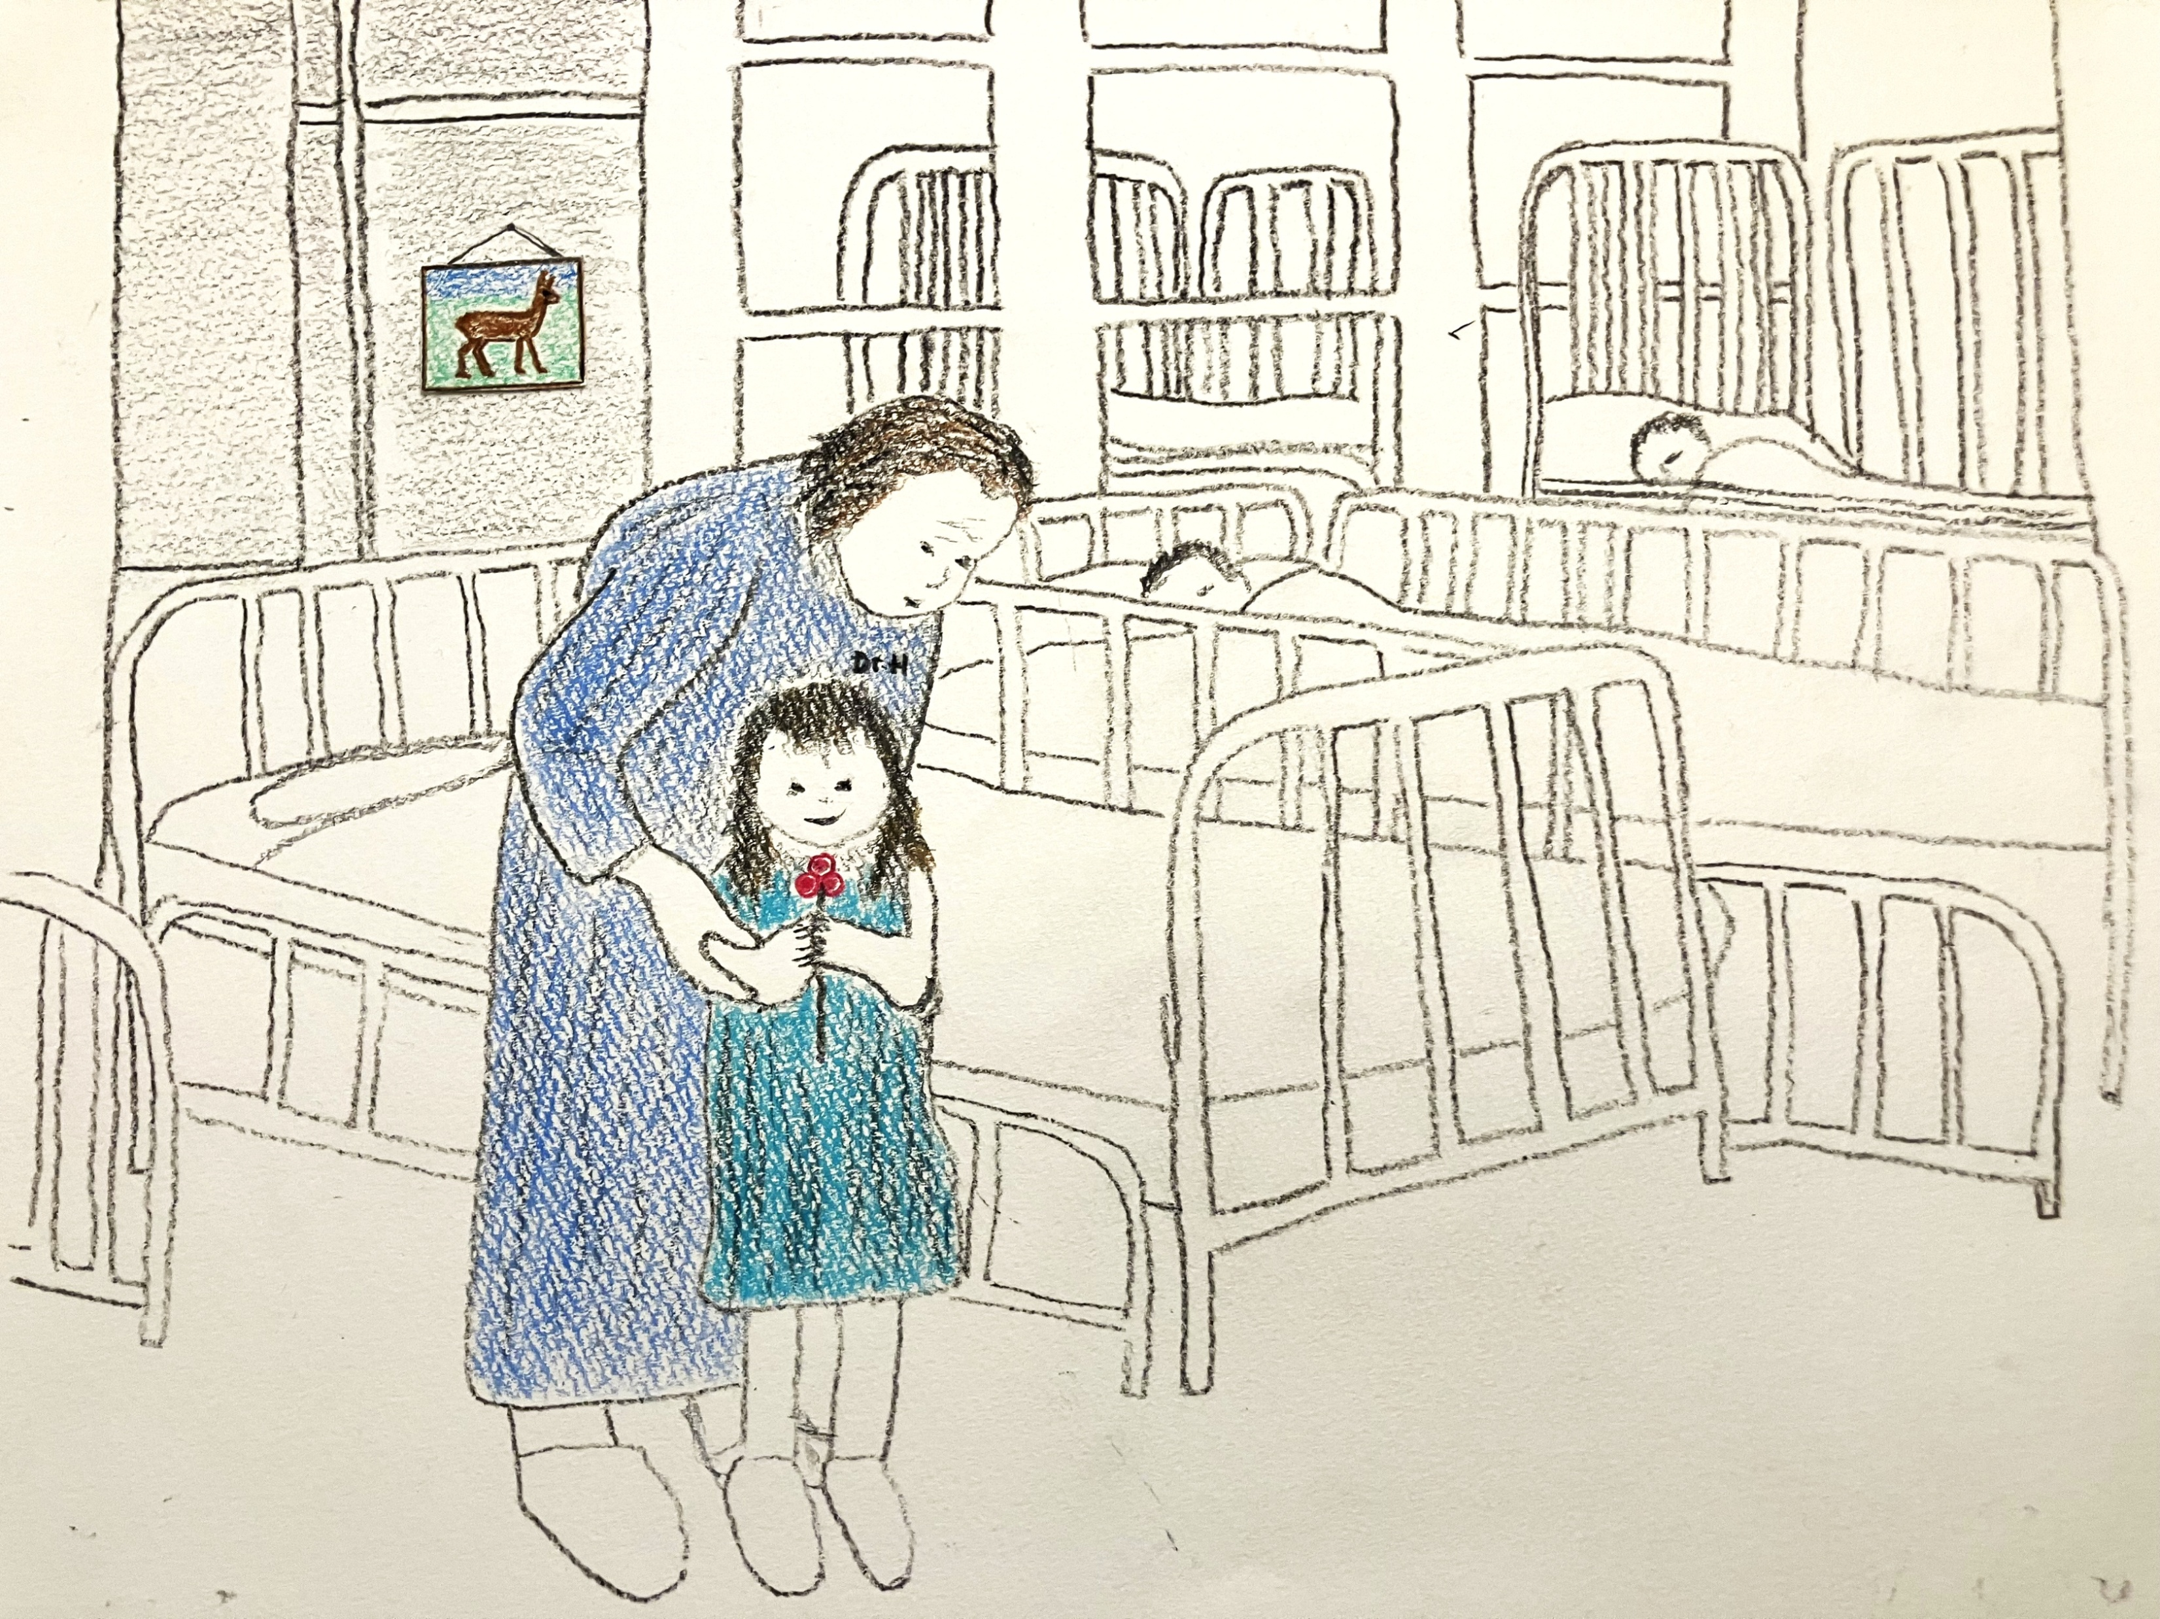
A depiction of the altruistic work and dedication of pediatricians
during the “Social Beauty Era” of children’s hospitals

Slide 6
Some will argue that pediatricians and nurses are a “special breed”— that they are unusually altruistic and not representative of humanity. But such a notion is not only untrue, but also an insult to the rest of humanity. It is not just most pediatricians and pediatric nurses that have performed altruistically despite absence of monetary incentive. It is also most hospital workers, including the housekeeping staff that not only mop the floors of patients’ rooms but also simultaneously engage in compassionate, comforting conversation with worried children and their parents. They do not have to do that, but they do.

Slide 7
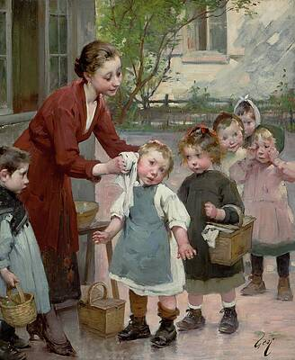
And what about schoolteachers, at least in the past, and many still? Schoolteachers work hard and contribute immensely, despite being on a salary, often an inappropriately low salary. Like physicians and nurses, their incentive is the gratifying thought and feeling that they are individually and collectively contributing to the meeting of children’s needs. Their work can generate sufficient spirit, incentive, meaning, and reward---unless the school workplace becomes damaged by arrogant and insensitive administrators who promote and mandate a misguided culture, curriculum, and teaching style.

Slide 8
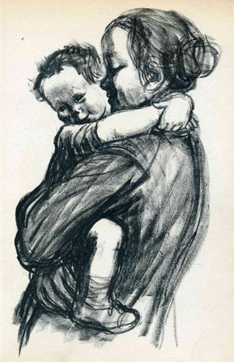
What about young mothers? Who works harder and longer hours and takes on greater responsibilities than mothers? Yet, mothers are not motivated by monetary incentive. They don’t change diapers or prepare meals on a “fee-for-service” basis. They do not even receive a salary, not even a low salary. Very often they do not even receive acknowledgement or praise for their hard, excellent work. Their hard work is typically taken for granted.

Slide 9
A mother’s hard work is motivated by moral incentive and an understood need, responsibility, and desire to contribute to an enormously worthy cause---the raising of children. It would be ridiculous to suggest a system by which mothers would be paid a fee-for-service reimbursement for each diaper change, each meal served, each scraped knee treated, each bedtime story read---and, even worse, to make that reimbursement contingent upon the mother’s adequate documentation and appropriate billing for each task performed.
It would also be ridiculous to suggest a system that would provide mothers with a salary that was contingent upon documentation of tasks done (“shadow billing,” or worse). And, yet, as absurd as such payment schemes would be for mothers, these exact same reimbursement schemes for physicians’ work have been implemented during the “Corporate Era” of children’s hospitals by corporate-trained and influenced health care administrators.

Slide 10
Factory workers and manual laborers of all types have demonstrated that they, too, are fully capable of performing their work exceptionally well without monetary incentive---even when not given the respect, supportive environment, and wage they deserve. The history of labor is replete with examples of workers who have gone “above and beyond the call of duty,” despite receiving no monetary rewards for doing so. This has included workers who have developed innovative, safer, better ways to perform industrial tasks---innovations that have improved the profits of the company but did not increase the wealth of the workers responsible for the innovations. These creative workers are known and highly respected by their fellow workers. They are motivated by an inner drive to contribute and by the respect they receive from their appreciative fellow workers.

Slide 11
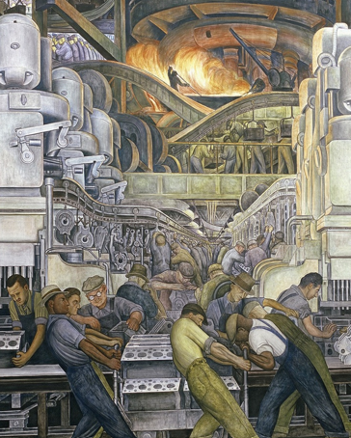
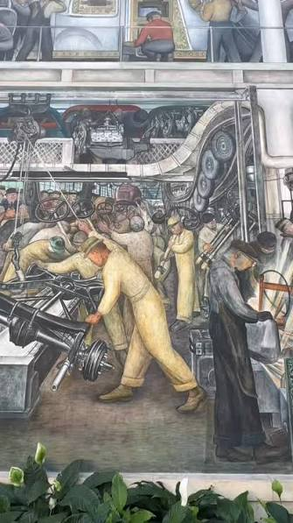
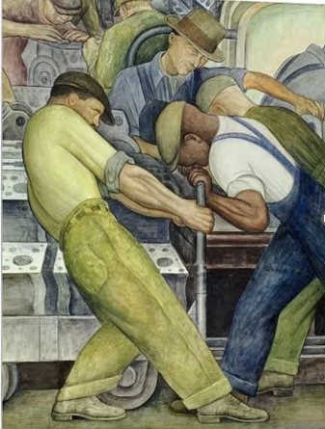

Slide 12
In fact, most human beings---workers in all walks of life---have shown great capacity to perform altruistically and do so to a considerable extent---particularly if they are treated with respect and work in an environment/culture that appreciates moral incentive and altruistic work.
Granted, if salaried physicians, nurses, teachers, et al., perform well to an above-average extent, they might anticipate an eventual raise. But that plays only a minimal role in why they work so hard. Moral incentive, not monetary incentive, is the major driving force, the major motivating force.

Slide 13
Despite the above evidence that moral incentive (not monetary incentive) has been capable of motivating a large percentage of the human population (perhaps the vast majority?) to perform their work well, why does the Corporate Capitalist economic narrative insist that monetary incentive is essential (the sine qua non) for an economic model to succeed? Why does the prevailing economic narrative have so little faith in and respect for human beings?
This negative view of human beings stems directly from the negative, incomplete, inaccurate, anti-human understanding of human nature upon which the capitalist model is based.
This flawed understanding of human nature is one of the deepest root causes of what is wrong with corporate capitalism.

Slide 14
This negative, anti-human view of human nature is espoused repeatedly by the promoters of the prevailing economic narrative and is used to justify that economic narrative. Some who espouse this negative view of human nature are doing so innocently, out of ignorance or naivete. Others are deliberately perpetuating this view of human nature because it serves to support the prevailing economic model and its dominance and control over Humanity.

Slide 15
We should realize, however, that this negative view of human nature that insists that human beings are unlikely to perform their work well in the absence of monetary incentive, is a form of “gaslighting” and represents a demeaning, abusive view of human beings. Those who promote this view may be speaking accurately about themselves but should not speak for all of humanity.

Slide 16
In my opinion, this negative view of human nature, this claim by corporate capitalists that monetary incentive is necessary for the success of any economic model, this denial that human beings can be sufficiently motivated by moral incentive, is a form of anti-human racism---the promotion of a prejudiced, derogatory, inaccurate assumption about the entire human race.
Is capitalism’s systemic promotion of its negative view of human nature not a form of systemic racism, directed against the entire human race? Are people who buy into this view, or otherwise allow it to prevail, not complicit in this form of systemic racism?

Slide 17
Over the centuries, many population groups have suffered much more than others from racism---e.g., blacks, native Americans, other indigenous peoples, Hispanics. Economic models and economic issues contributed greatly to these examples of racism. We owe it to the people who have suffered the most from racism to develop and implement a social and economic model that honors and promotes respect for all human beings. The CHPEM does so and does so equitably.
In honor of those who have suffered the most from racism, it is high time to abolish all forms of racism, including prejudiced, derogatory, inaccurate assumptions about the entire human race. This includes acknowledgement that certain economic models promote prejudiced, derogatory, inaccurate assumptions about others.

Slide 18
Conclusion:
There is ample experiential evidence that human beings, guided by moral incentive, can accomplish great things for each other (and themselves), without need for monetary incentive.
To insist that monetary incentive is essential for any economic model to be successful is incorrect and is an abusive insult to the human race.

Slide 19
Sowing Seeds of Social Beauty
Thank you
for your attention
and for
your interest in
Sowing Seeds of Social Beauty
Notes:
This presentation serves as an introduction to a course entitled Sowing Seeds of Social Beauty: The Untold Story of the Children’s Hospital Public Economy Model (CHPEM)

