Slide 1
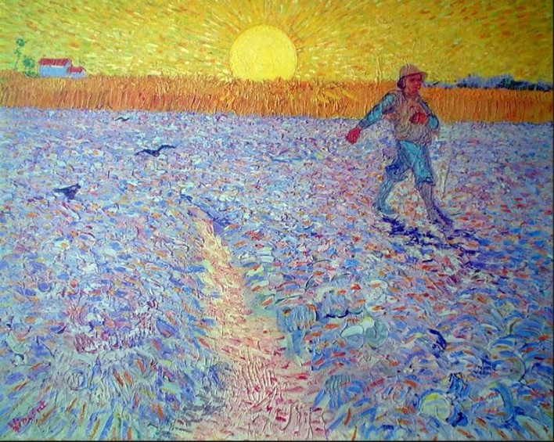
Sowing Seeds of Social Beauty
Presentation 9:
Competition

Slide 2
A fundamental belief among those who promote the Corporate Capitalist Economic Model is that “competition” is an essential element for a successful economic system.
The belief is that “without competition, people and companies will not have sufficient incentive to work hard and perform well.”
Capitalism’s misunderstanding of human nature and capitalism’s misunderstanding of the true meaning of competition are two main reasons why people mistakenly believe that capitalism is the “best and only realistic economic model for humankind.”.”

Slide 3
It is true that “competition,” properly understood and properly practiced, can be a good thing, at least in sports and leisure activities, and is one way to add excitement, fun, and bring out the best in people as they seek to improve themselves, individually and collectively.
The key and the difficulty is the proper understanding, proper role, and proper practice of competition---because competition, improperly understood and improperly practiced, is usually not a good thing and tends to bring out the worst in people.

Slide 4
So, what is the “proper understanding” and “proper role” of competition, and how is it “properly practiced?”
By definition, “competition,” contrary to popular belief, is not about “beating others,” or “being better than others,” or “being the best.” It is not even about “winning” or “losing,” and it certainly is not about “defeating” or “crushing” opponents.

Slide 5
The word “competition” comes from the two Latin words “com” and “petere.”
“Petere” means “to seek,” and “com” means “with” or “together.”
So, the word “competition,” accurately understood, means “to seek together,” or “to seek (new heights) together.”

Slide 6
Thus, “competition” is simply one means by which people can work together to create an atmosphere and a spirit that will encourage and help all participants to reach new heights of accomplishment, and to enjoy the process of doing so.
It is about all helping each other, so that all can get better (and/or have fun), both as individuals and as a group.

Slide 7
The highest purpose of competition is not to determine who is “better,” but, rather, to create a process and a fun atmosphere that will help all participants answer The Question: “How good can we become” (e.g., in playing a sport), both individually and as a group, if we all dare to commit ourselves to the following Practice Principles:
Work hard and try hard---though not beyond a healthy extent.
Be disciplined---not only in work habits, but also in behavior towards each other.
Genuinely encourage and help each other. Sincerely hope for others to get better, along with ourselves getting better.
Create high spirit and a fun atmosphere for each other (even including “trash talk” in fun, if desired).

Slide 8
For competition to succeed in serving of its highest purpose, the process of answering “The Question” must be held to be much more important than the answer itself.
That is, success is measured not by the actual answer, but by the extent to which (and the way in which) The Question is answered (which requires adherence to and execution of the “Practice Principles” just mentioned).

Slide 9
The purpose of swim competition is to help all participants answer The Question: “How good can we become, individually and collectively, if we dare to commit ourselves to the Practice Principles?”
If all members of each team commit themselves to answering The Question (and, thereby, commit themselves to the Practice Principles), and if they all try their very best to do so, then the final standings for a given team or a given individual, though very interesting, are beside the point.
Even the team that finishes last, even the swimmer who turns out to be the slowest, succeeds (“wins”), because each dared to do what was necessary to answer The Question, each arrived at the answer, and each benefitted from the process.

Slide 10
Although the answer itself is often very exciting for some (e.g., those for whom the answer indicates exceptional talent), the answer for many may feel disappointing. That is why it is so important that all participants recognize that it is the process that is most important, not the final standings.
Answering The Question is more important than what the answer turns out to be. The performances of those for whom the answer turns out to be “first” or “best” deserve to be marveled at and appreciated for the extraordinary talent those performances reflect.
But doing what is necessary to answer The Question (i.e., successfully executing the Practice Principles) should be admired and celebrated the most.

Slide 11
Besides, one of the purposes of answering The Question (in sports, e.g.) is to find out the truth.
If a person’s truth turns out to be that they have limited talent, that truth is worth knowing, and even more importantly, worth knowing how to accept in a healthy way.
An important part of life is learning who we are, what our limitations are, how to accept who we are in the healthiest way, and how we can best improve.

Slide 12
It is essential to strongly emphasize the importance of genuinely and sincerely encouraging, helping, and hoping for others to get better. A symptom of competition being poorly understood and poorly practiced is a lack of such genuine caring among participants.

Slide 13
Genuinely and sincerely encouraging the success of others can be the most difficult aspect of properly practicing competition.
Psychologically, it is hard not to covet the success of another, particularly if one’s own talents and accomplishments feel diminished in comparison. We all need help with these feelings.
The secret is for all to properly understand the true meaning, purpose, value, and role of competition.
Without all participants understanding and practicing competition properly, it is more difficult for an individual to practice it properly. Good coaches and good teams know how to do this.

Slide 14
A helpful thought to keep in mind is to focus on competing against yourself---i.e., focus on comparing how you are doing now to your past performances; i.e., focus on your self-improvement, rather than focusing unhealthfully on comparison with others.

Slide 15
Indeed, a major purpose of engaging youth in sports competition is to teach them the proper understanding and practice of competition.
When done properly, competition helps youth to establish the habit of “wanting to answer The Question,” teaches them how to properly go about doing it, and helps them deal with the answer in a healthy way.
They can take great pride in and draw strength from the fact that they dared to ask and properly answer The Question.

Slide 16
A proper understanding and the proper practice of competition are not easy.
The proper practice of competition represents an ideal that is barely realistic in the healthiest imaginable culture and is totally unrealistic in an unhealthy culture (one in which an inaccurate, perverted, cut-throat understanding of competition is practiced and encouraged).
When competition is poorly understood and poorly practiced, it tends to do great harm to all concerned---including harm to those who are trying to practice competition properly.

Slide 17
To what extent does the concept of “competition” practiced and promoted in the Capitalist Economy resemble the concept just discussed?
Have practitioners of current global capitalism been demonstrating a proper understanding and proper practice of competition?
Do businesses in the same industry enthusiastically and collaboratively “seek new heights together” with their “competitors?” Do businesses that “are in competition with one another” strive to genuinely and sincerely encourage, help, and hope for their fellow competitors to reach their maximum potentials?

Slide 18
Or, has the Capitalist Economy been practicing a perverted, cut-throat version of competition? Does the “competition” promoted and practiced in the Capitalist Economy seem to be all about “winning,” “defeating,” “crushing,” “beating others,” “being better than others,” being #1,” scheming to dominate the market (at the expense of others and by any means necessary), boasting about “being best” (even when it is not true), and hoping that the competition will somehow fail, even purposefully making moves to impair or discourage the competition?

Slide 19
It appears that proponents and apologists for the Capitalist Economic Model have grossly misunderstood the true meaning and purpose of “competition,” and are espousing and practicing an unhealthy, perverted, vulgar version of it---a version that tends to bring out the worst in people.
Worse, with this economic model, the success of a business, realistically, depends on how well it executes this twisted, perverted understanding and practice of “competition.”

Slide 20
Do we really want an economic system that promotes and depends upon such a perverted, vulgar, unhealthy, and incorrect understanding and practice of competition?
Is it even necessary to inject properly understood and properly practiced competition into economic activity, at all---particularly considering how difficult its proper practice is, how many pitfalls it involves, and how idealistic it is to expect people to practice it properly, especially in our current culture?
Is it best to limit competition to the realms of sports and games and leave competition out of economic activity?

Slide 21
Couldn’t we develop an economic system that says, in essence, “These are the needs. Let’s all work together to see how well we can meet them.” Historically, that is exactly what the Children’s Hospital Public Economy Model (CHPEM) has done, for many decades. Academic pediatricians have not needed or desired the perverted version of competition promoted by the Capitalist Economic Model. Academic pediatricians have not even needed or desired the injection of a properly understood and properly practiced form of competition into their work. They have wisely concluded that any purported “benefits” of injecting properly practiced competition into their work are greatly outweighed by the realistic pitfalls involved. The only sense in which Academic Pediatricians have participated in competition against another has been to “compete against the diseases of childhood”---and in this sense, they have sought new heights together---com petere.

Slide 22
Sowing Seeds of Social Beauty
Thank you
for your attention
and for
your interest in
Sowing Seeds of Social Beauty
Notes:
This presentation serves as an introduction to a course entitled Sowing Seeds of Social Beauty: The Untold Story of the Children’s Hospital Public Economy Model (CHPEM)

